Slide 1
A temperature Scale of 1.3 eV in the Observed Mass and Radius Relationship of White Dwarfs
Jin Lim
Adviser : Maurice H.P.M., van Putten
Dept. of Astronomy and Space Science, Sejong Univ
Notes:
Hello, My name is Jin Lim. And my adviser is Maurice.
Today I will present my master thesis the name of “A temperature Scale of 1.3 eV in the(디) Observed (Mass and Radius Relationship) (뛰고)
of White Dwarfs”

Slide 2
Introduction
Mass-Radius Relationship with Temperature Normalization
Temperature Normalized Relations
CONTENTS
Ranking by Monte Carlo Simulation
Interpretation of Results
Conclusions and Outlook
Notes:
Contents consist of 6 parts,

Slide 3
Introduction
Notes:
In this part, I will briefly present the basic of white dwarfs.

Slide 4
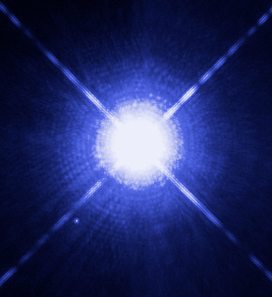
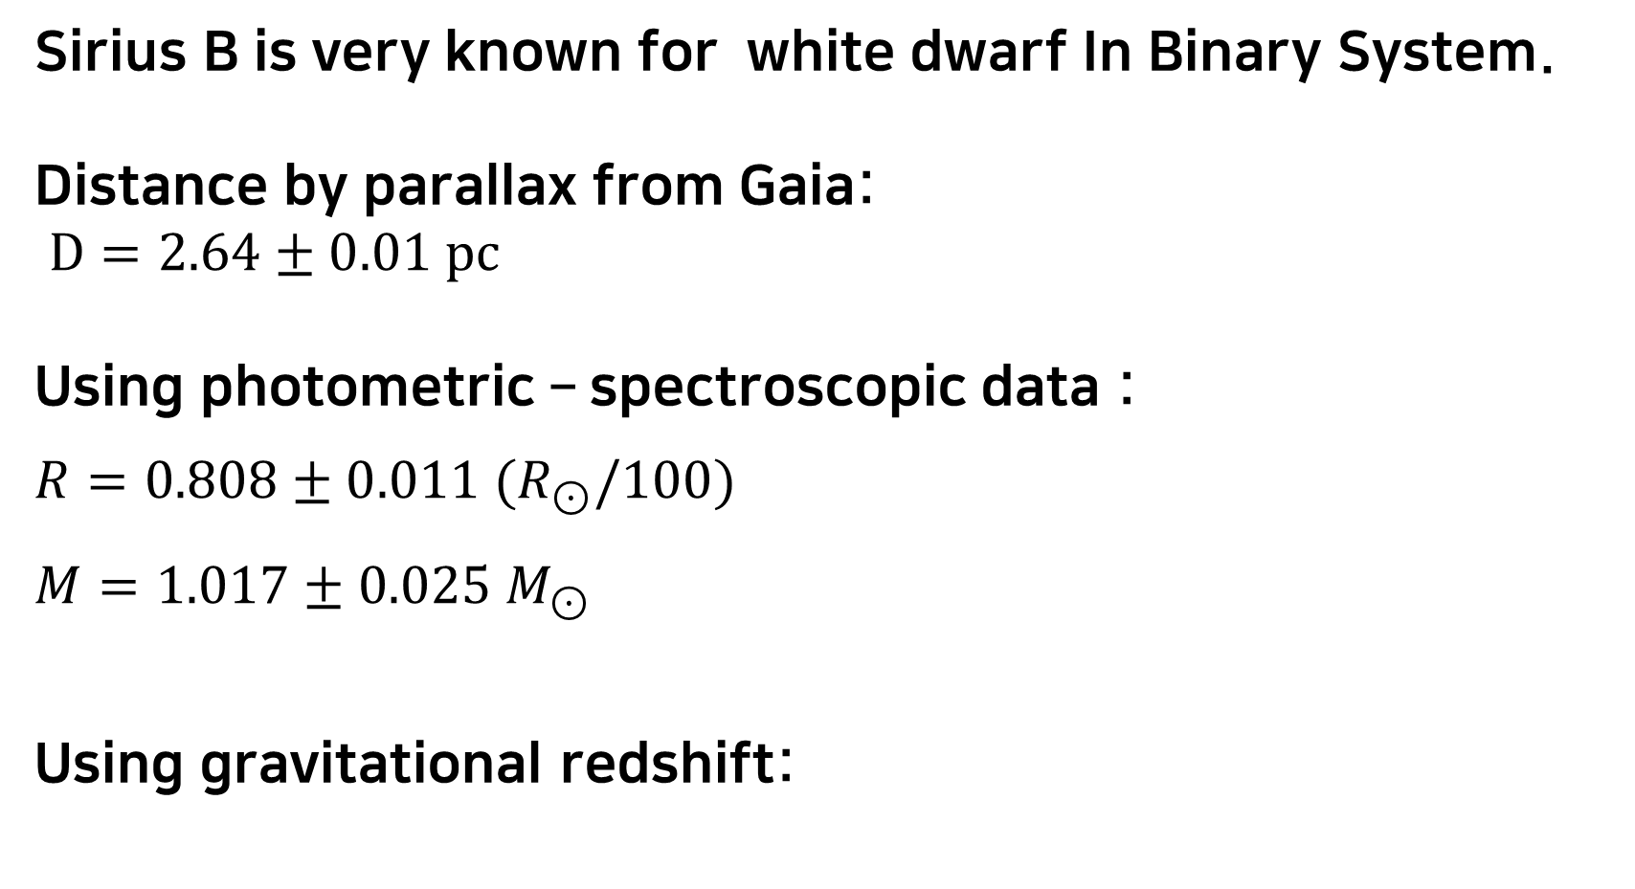
Sirius B – Typical White Dwarf
Sirius B is very known for white dwarf In Binary System.
Distance by parallax from Gaia:
$D=2.64±0.01 pc$
Using photometric – spectroscopic data :
$R=0.808±0.011 {(R}_{⊙}/100)$
$M=1.017±0.025 M_{⊙}$
Using gravitational redshift:
$$V_{z}=\frac{λ_{obs} −λ_{rest}}{λ_{rest}}×c =\frac{R_{g}}{R}c=80.65±0.77 km/s$$
Credit : ASA, ESA, H. Bond (STScI), and M. Barstow
Notes:
White dwarf is light and middle mass star ending point of the evolution. And they can not make nuclear fusion energy itself, white dwarf keep cooling and release energy only heat.
(Enter)This is a Typical white dwarf , Sirius B. White dwarfs are quite faint and small, so there are serval measurements (매져) to calculate properties. For example, mentioned Sirius B case, it can get distance by using parallax, and radius and mass can get precisely using photometric and spectroscopic method like this (쉬고). These two methods are conventional methods to get radius and mass.
Not only that there are other ways to get radius and mass, (enter) one of examples is Gravitational redshift. Gravitational redshift also can get their radius and mass. (enter) However this method sometimes can bring quite large error. So, it is not always to bring precise information.
Even so using these methods, it possible to get information of white dwarfs.
Next, I’ll show the white dwarf observed properties and theoretical properties.
(white dwarf의 미름은 1922년 빌렘 Luyten (루이덴)에 의해 불림. )

Slide 5
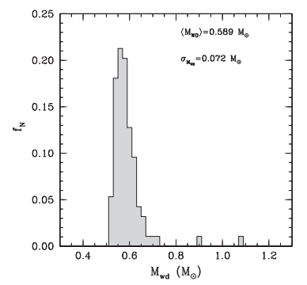
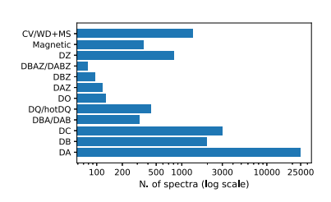
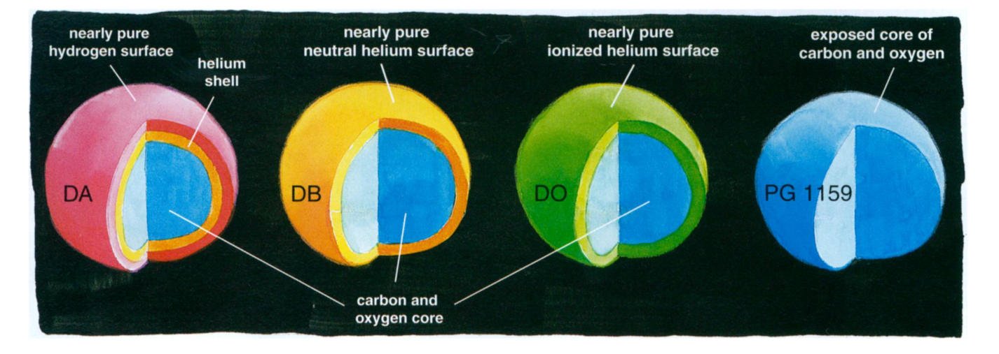
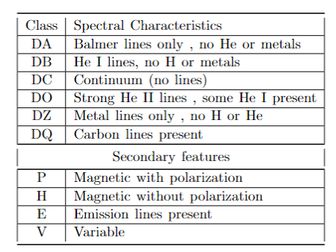
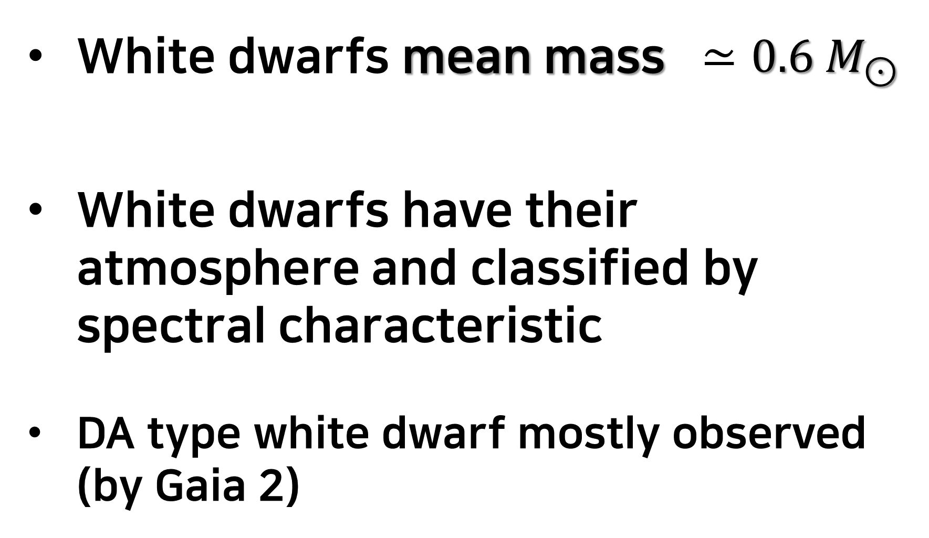
White Dwarf Observed Properties
White dwarfs mean mass $≃0.6 M_{⊙}$
White dwarfs have their atmosphere and classified by spectral characteristic
DA type white dwarf mostly observed (by Gaia 2)
Credit: Santiago Torres and Alberto Rebassa-Mansergas et al. 2021
Credit: Kawaler & Dahlstrom (2000)
A catalogue of white dwarfs in Gaia EDR3 N. P. Gentile Fusillo
Notes:
First, I present several observed properties of white dwarfs.
One is white dwarfs’ mean mass. (쉬고) According to the (디) observed mass distribution (쉬고) of white dwarfs, white dwarf mean mass
is (쉬고) 0.6 (point six) solar mass.
Second, White dwarfs have their atmosphere (enter) and classified by spectral characteristic (enter) For example, if in white dwarf spectra detected only Balmer lines, (enter) that is DA type white dwarf and (enter) we can think that this white dwarf has nearly pure hydrogen surface.
And among these types, (enter) DA type white dwarfs are mostly observed.
So far , I present the white dwarfs observed properties. Next I’ll present the white dwarfs theory.

Slide 6

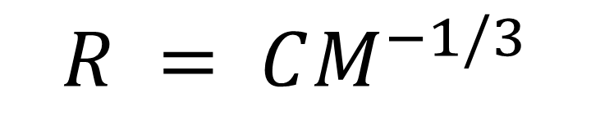
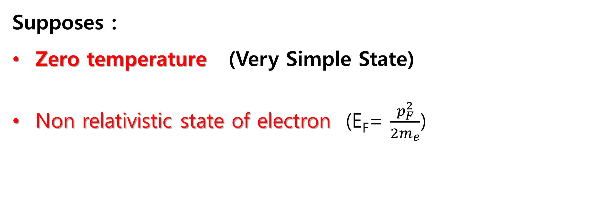
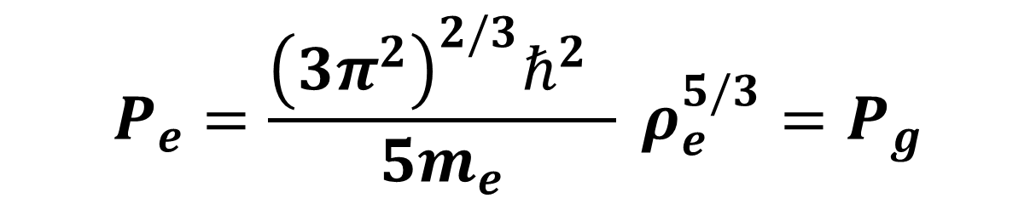
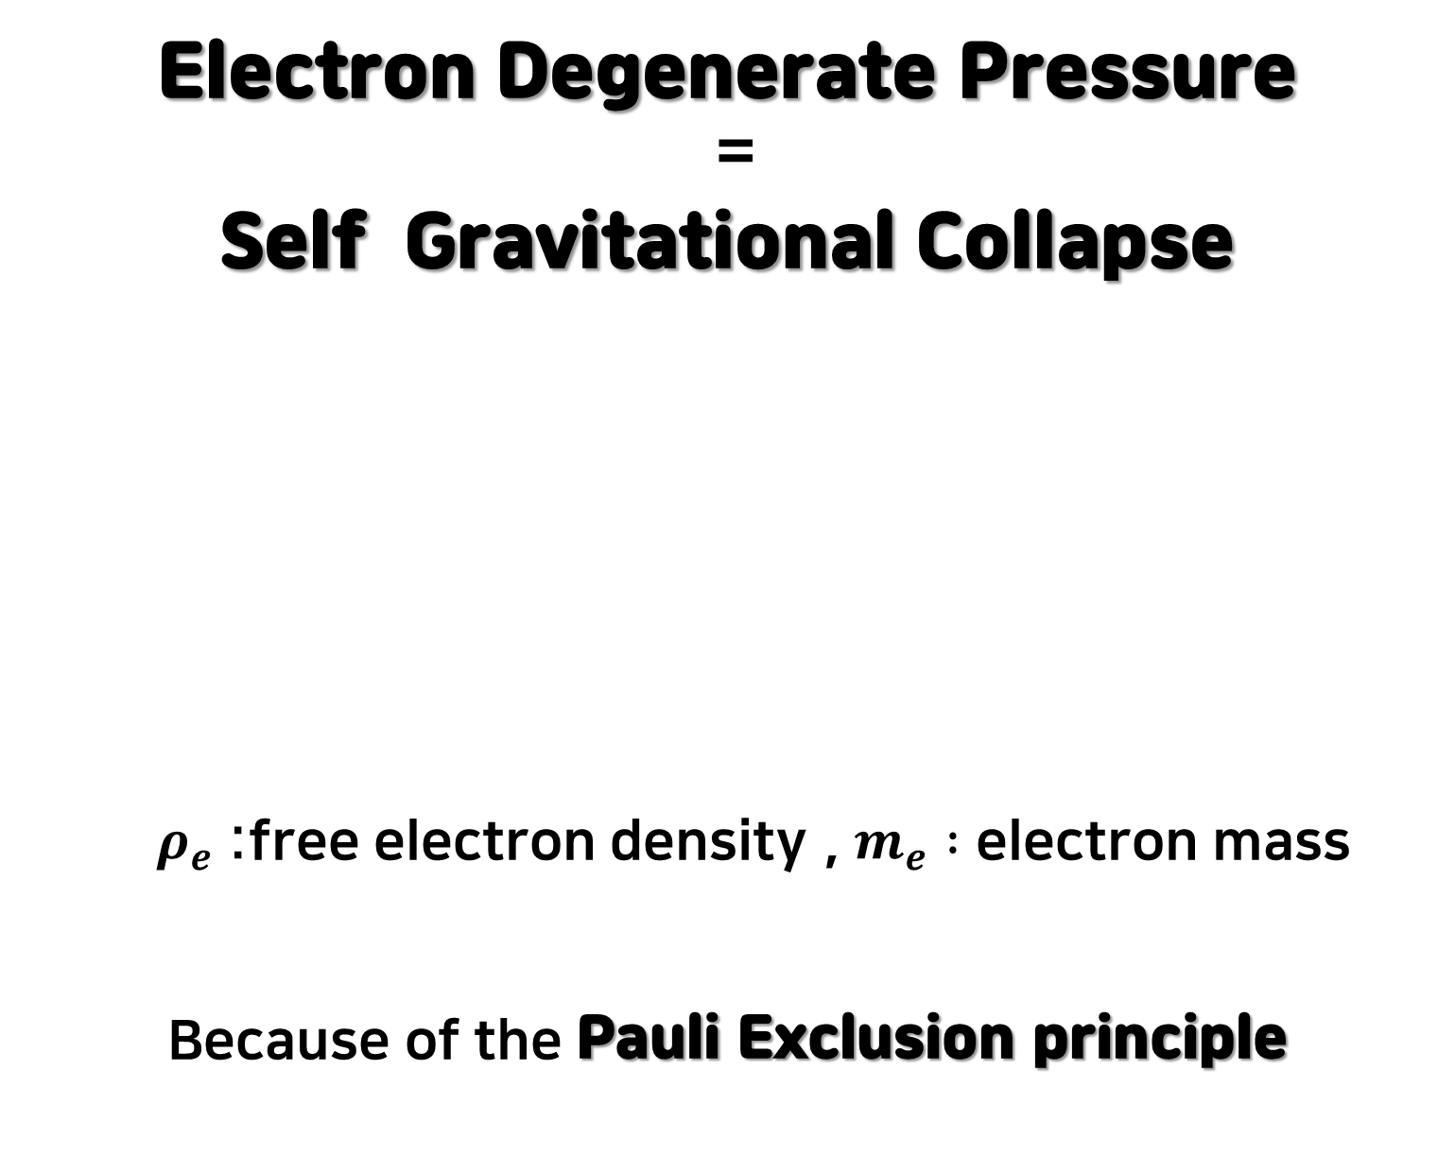

White Dwarf Theory (Chandrasekhar)
Electron Degenerate Pressure
=
Self Gravitational Collapse
$ρ_{e}$:free electron density , $m_{e} :$ electron mass
Because of the Pauli Exclusion principle
3. But, certain pressure prevent white dwarf collapse.
1. White dwarfs can not make nuclear fusion energy.
Fermi gas Equation Of State(EOS)
$$P_{e}=\frac{{\left(3π^{2}\right)}^{2/3}ℏ^{2} }{5m_{e}} ρ_{e}^{5/3}=P_{g}$$
Because of White dwarf
self gravity,
We could think that White dwarf
is going to collapse.
$$R = CM^{−1/3}$$
If) Relativistic state of electron ($p_{F}>m_{e}c$)
Supposes :
Zero temperature (Very Simple State)
Non relativistic state of electron (E_{F}= $\frac{p_{F}^{2}}{2m_{e}}$)
$$M_{ch}=1.44M_{⊙}⁡$$
Chandrasekhar mass limit
Notes:
White dwarfs can not make nuclear fusion energy itself. (enter) Because of White dwarf self gravity, We could think that White dwarf is going to collapse. (enter)
However, certain pressure prevent white dwarf collapse. That is electron degenerate pressure, it balanced with self gravitational pressure because of the Pauli Exclusion principle. (enter) For driving this equation, we set two suppose. One is zero temperature , the other is non relativistic state of electron.
Using this equation, we can get radius and mass relationship of white dwarf. If electron state is relativistic, we can get white dwarf limit mass called Chandrasekhar limit mass.

Slide 7
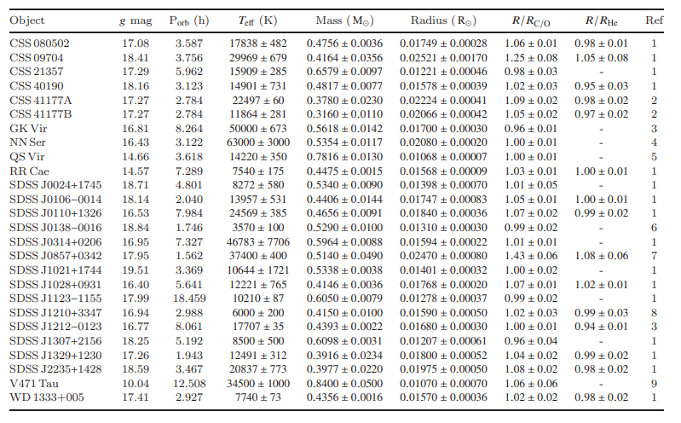
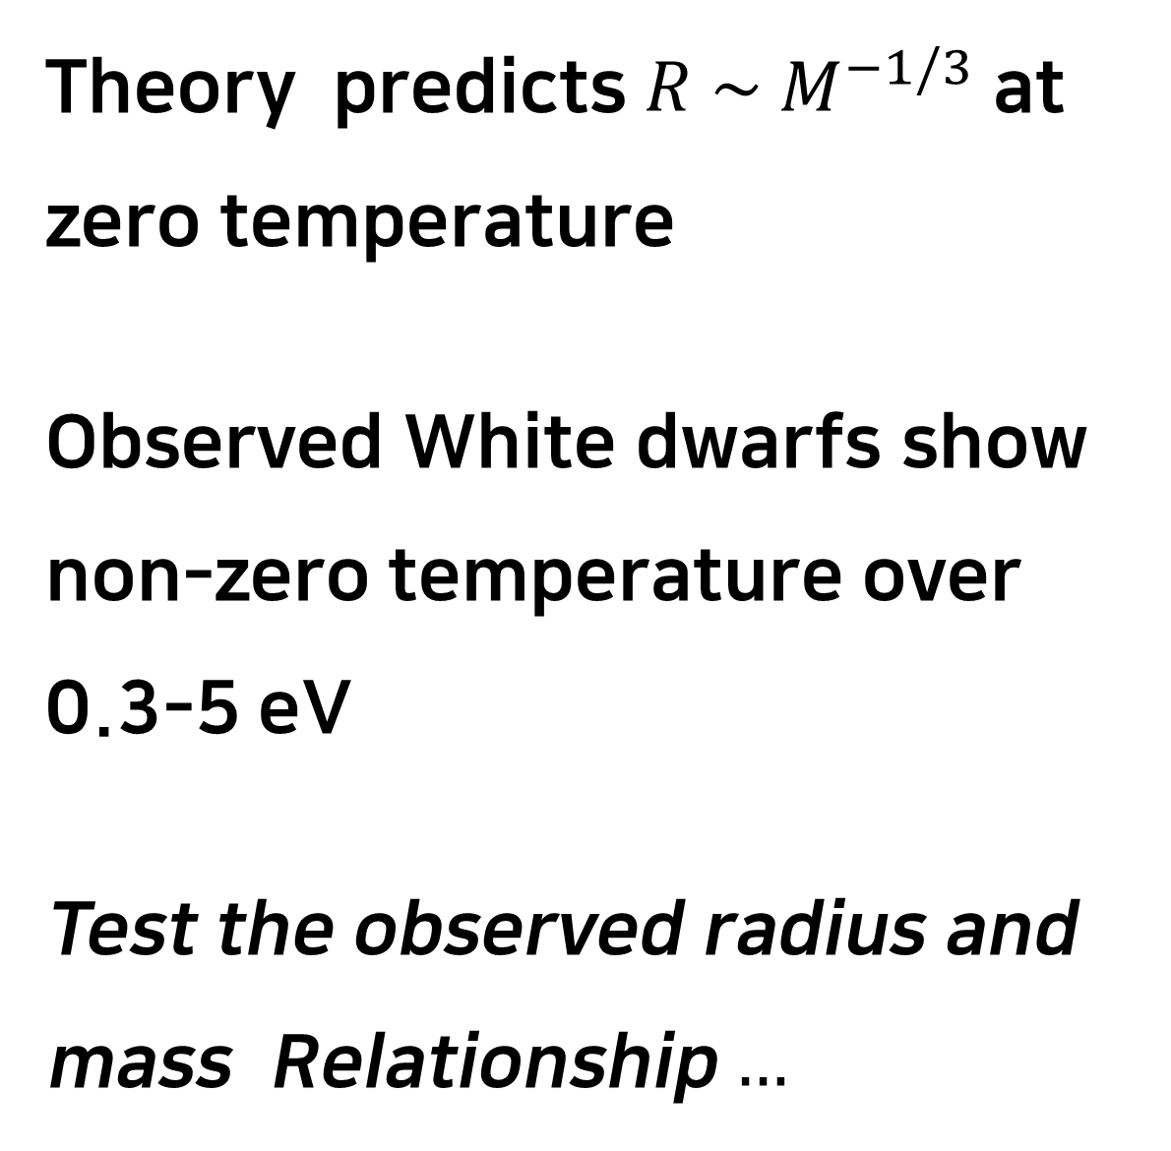
Parsons et al. 2017 data
Theory predicts $R \sim M^{−1/3}$ at zero temperature
Observed White dwarfs show non-zero temperature over 0.3-5 eV
Test the observed radius and mass Relationship $…$
Parsons used Photometric
and Spectroscopic method
to calculate precisely.
Total number : 26
Type : DA (Balmer lines) &
White Dwarfs in Eclipsing Binaries
* Parson 2017 , Testing the white dwarf mass-radius relationship with eclipsing binaries
Notes:
To test radius and mass relation of white dwarfs, we used Parson 2017 data. Parsons used Photometric and Spectroscopic method to calculate precisely. Parsons use 26 (twenty six) white dwarfs which DA type and these white dwarfs are in eclipsing binaries.
(enter) Theory predicts radius and mass relation at zero temperature, however, observed White dwarfs show non-zero temperature over from 0.3 (point three) to 5 eV.
Now, Let’s test the (디) observed radius and mass relationship.

Slide 8
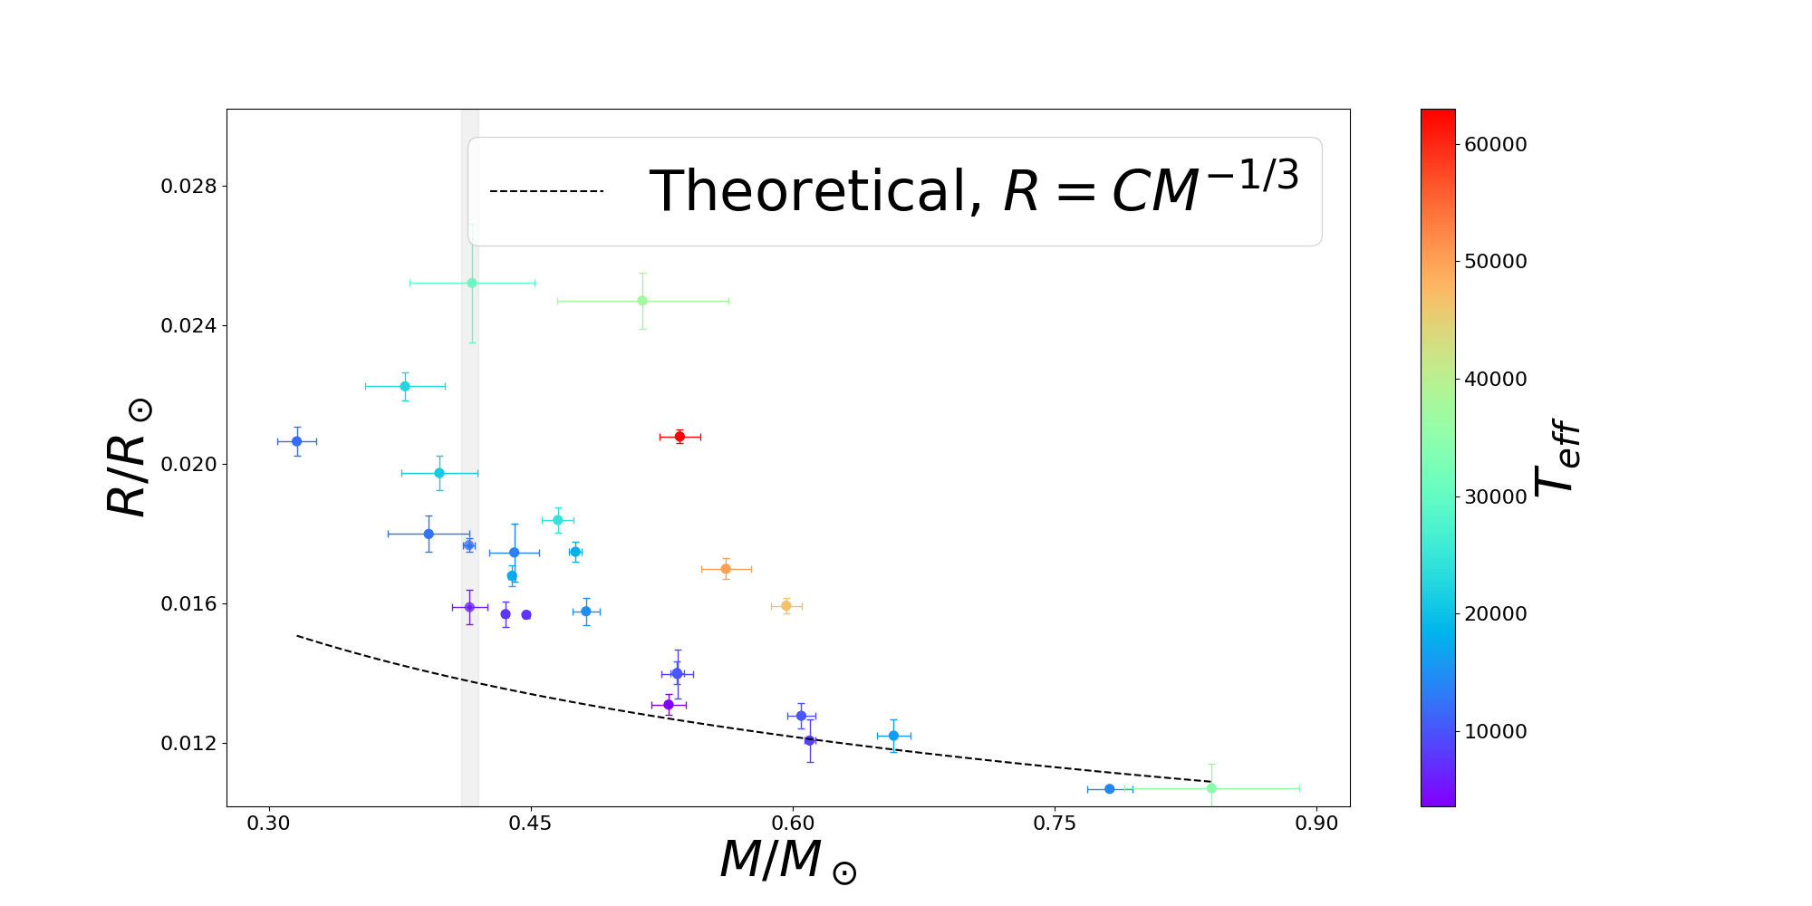
Radius and Mass Distribution With Temperature
Distribution of Radius and Mass With Temperature
Theoretical radius and observed radius don’t match (Dashed Line)
Notes:
This figure is the distribution of observed radius and mass with temperature.
Horizontal axis is Mass vertical axis is radius, and color is corresponding to temperature (쉬고) that blue is cooler and red is hotter. And dot line is theoretical radius and mass relationship.
We can see that theoretical radius and observed radius not match on this figure.
Now, to see more closer, we focus on the gray region. (enter) 1.5s 넘기기.

Slide 9
Mass-Radius Relationship with Temperature Normalization
Notes:
In this part, I’ll show the radius and mass relation with temperature normalization.

Slide 10
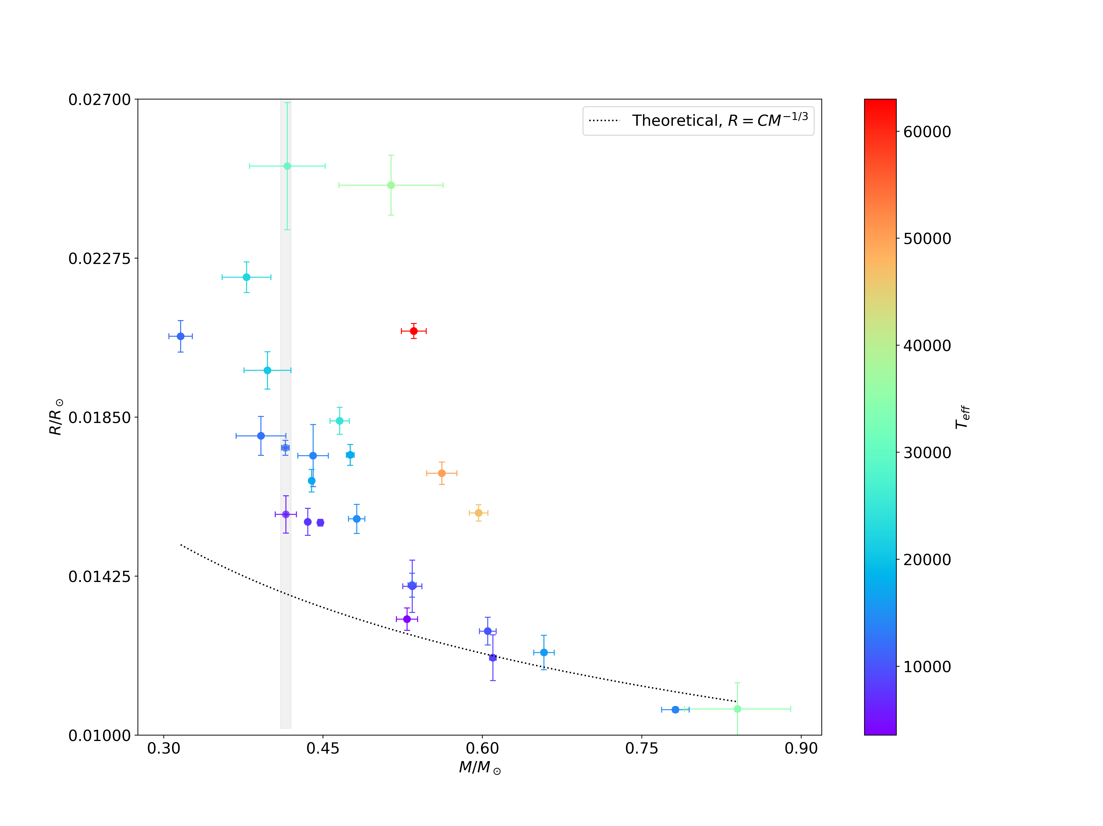
Radius and Mass Distribution With Temperature
Object | T_{eff} (K) | T_{eff} (eV) | M☉ | R☉
CSS 09704 | 29969 | 2.583 | 0.4164 | 0.02521
SDSS J1028+0931 | 12221 | 1.053 | 0.4146 | 0.01768
SDSS J1210+3347 | 6000 | 0.517 | 0.4150 | 0.01590
Similar mass but different radius.
Similar mass case,
hotter white dwarfs have relatively larger radius than cooler white dwarfs.
Notes:
Gray region shows that similar mass to 0.415 (point four one five) solar mass, But these white dwarfs have different radius.
These three white dwarfs have similar mass, and correspondingly we can see that hotter white dwarfs have relatively larger radius than cooler white dwarfs. And this trend shows not only these three white dwarfs but also shows at total data.
These trend is difficult to explain theoretical radius and mass relation because Theoretical radius is only affected by mass.
Now, we used a temperature as a factor, we try to explain these trend.

Slide 11
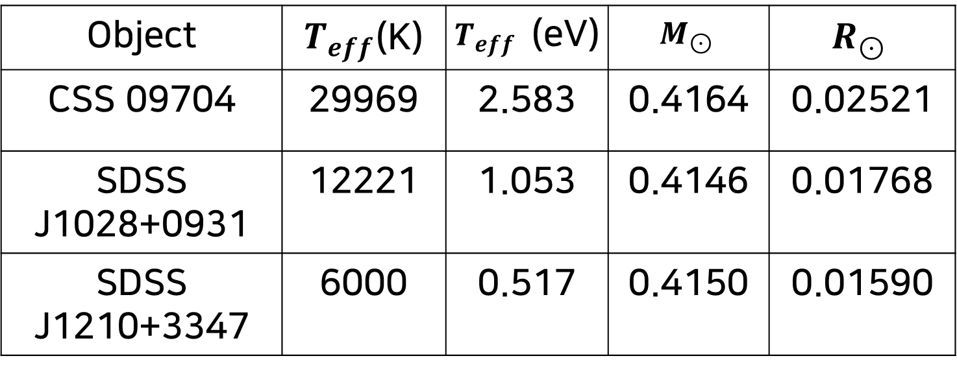
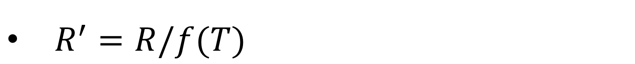
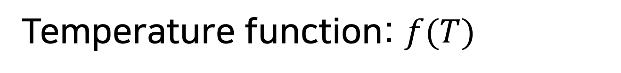
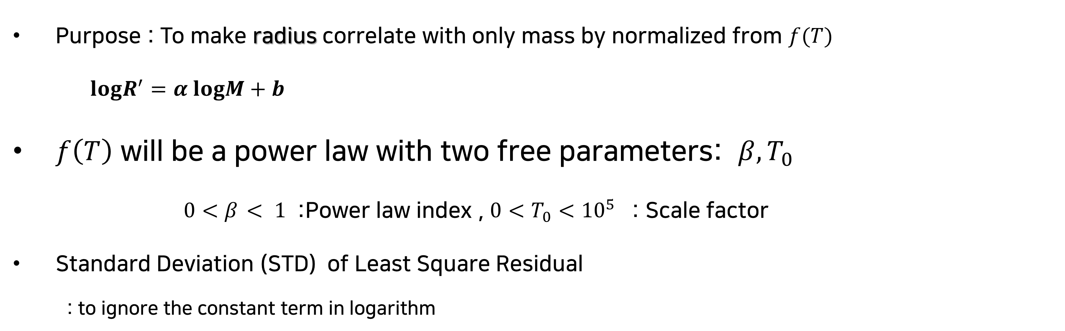
R - Normalization
$R^{′}=R/f(T)$
Temperature function: $f(T)$
Purpose : To make radius correlate with only mass by normalized from $f(T)$
$logR^{′}=α logM+b$
$f\left(T\right)$ will be a power law with two free parameters: $β,T_{0}$
$0<β_{ }< 1$ :Power law index , ${0<T}_{0}<{10}^{5}$ : Scale factor
Standard Deviation (STD) of Least Square Residual
: to ignore the constant term in logarithm
Object | $T_{eff}$(K) | $T_{eff}$ (eV) | $$M_{⊙}$$ | $$R_{⊙}$$
CSS 09704 | 29969 | 2.583 | 0.4164 | 0.02521
SDSS J1028+0931 | 12221 | 1.053 | 0.4146 | 0.01768
SDSS J1210+3347 | 6000 | 0.517 | 0.4150 | 0.01590
Notes:
When we test the observed radius and mass relation with temperature, we will use
R-normalization. R- normalization is that the(디) observed radius is dividend to temperature function f(T). R- normalization makes linear fit in log-log plan and (enter) explain the data trend.
(enter) F(t) will be a power law with two free parameters , beta and T0. beta is used it power index in f(t) and T0 makes temperature dimensionless. And we use Standard Deviation for least square residual to ignore constant term in logarithm.
Now using R- normalization and Standard deviation, we make three relations which have different temperature function f(T).

Slide 12
Temperature Normalized
Relations
Notes:
Now I’ll show the test three temperature normalized relations to test observed radius and mass relation.

Slide 13
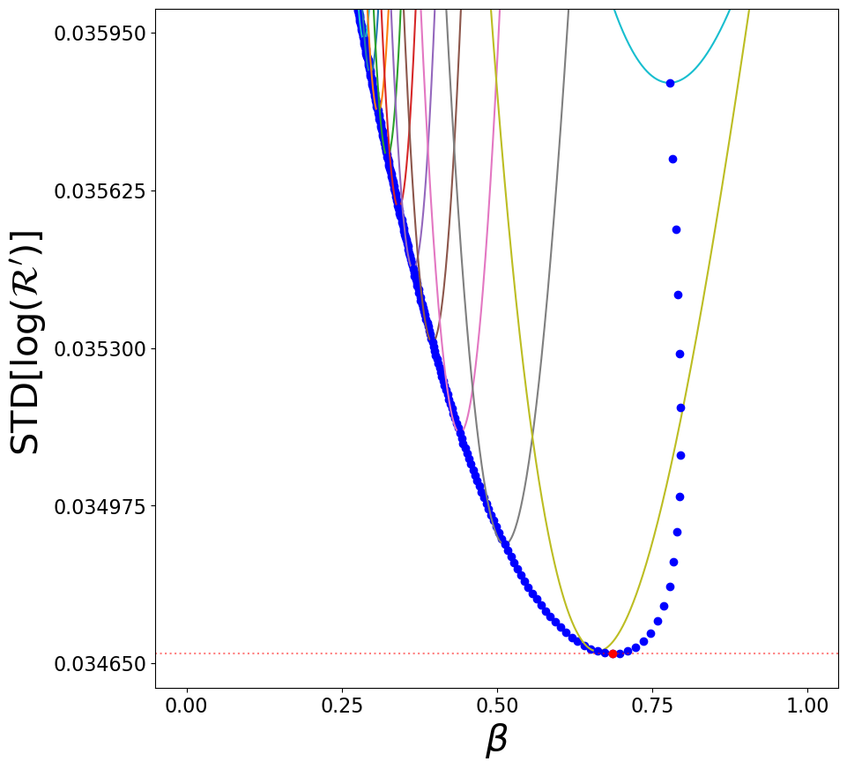
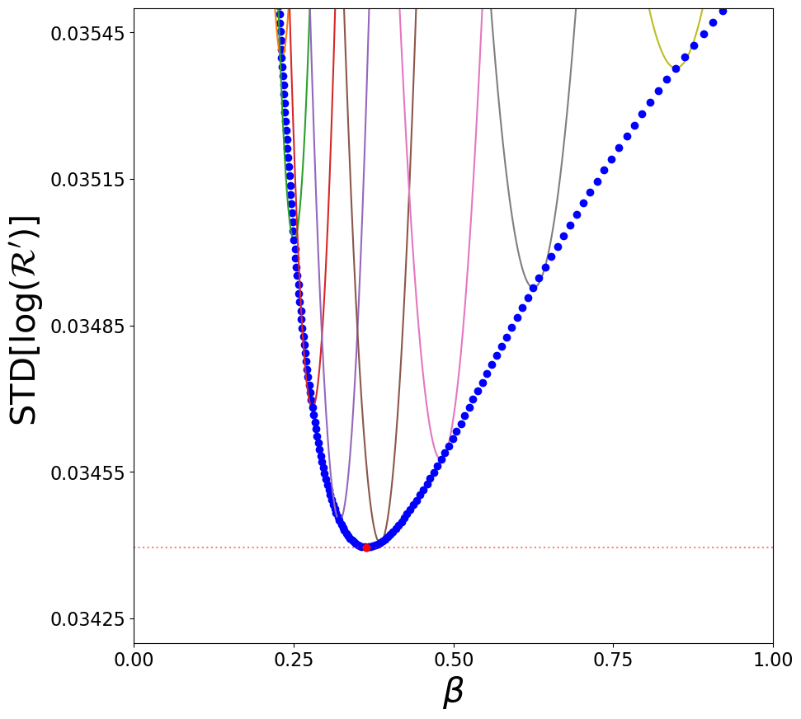
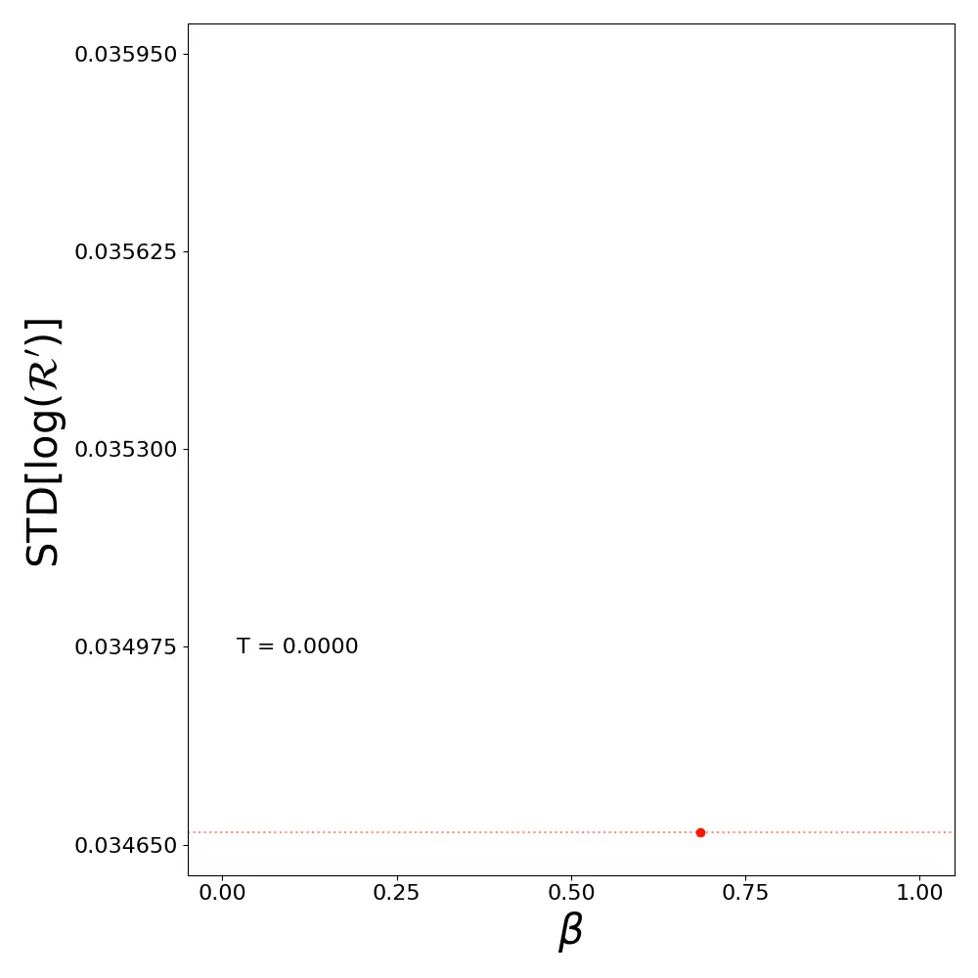
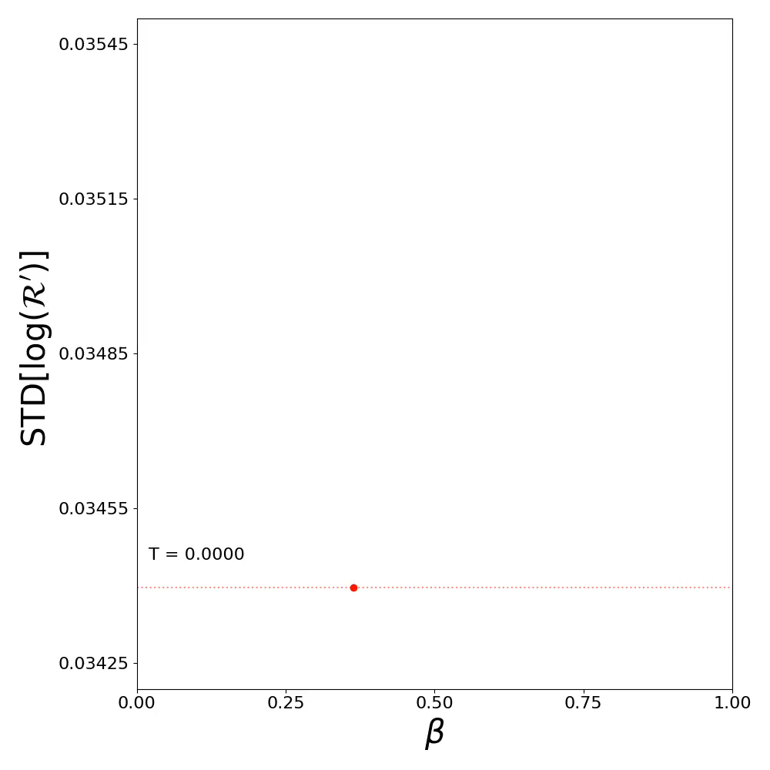
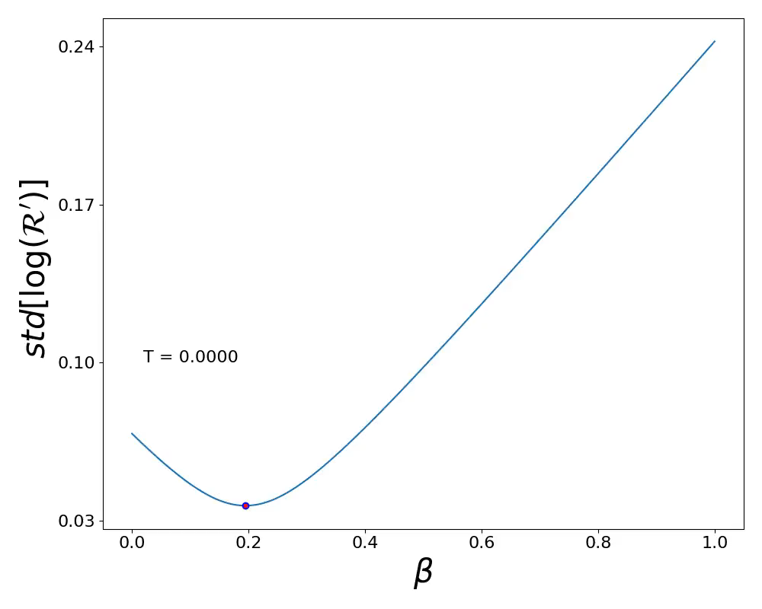

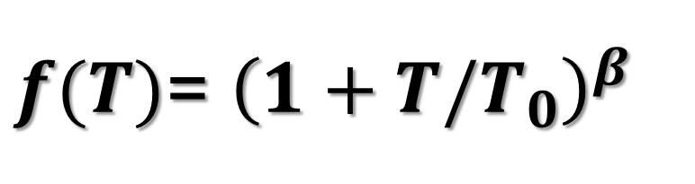
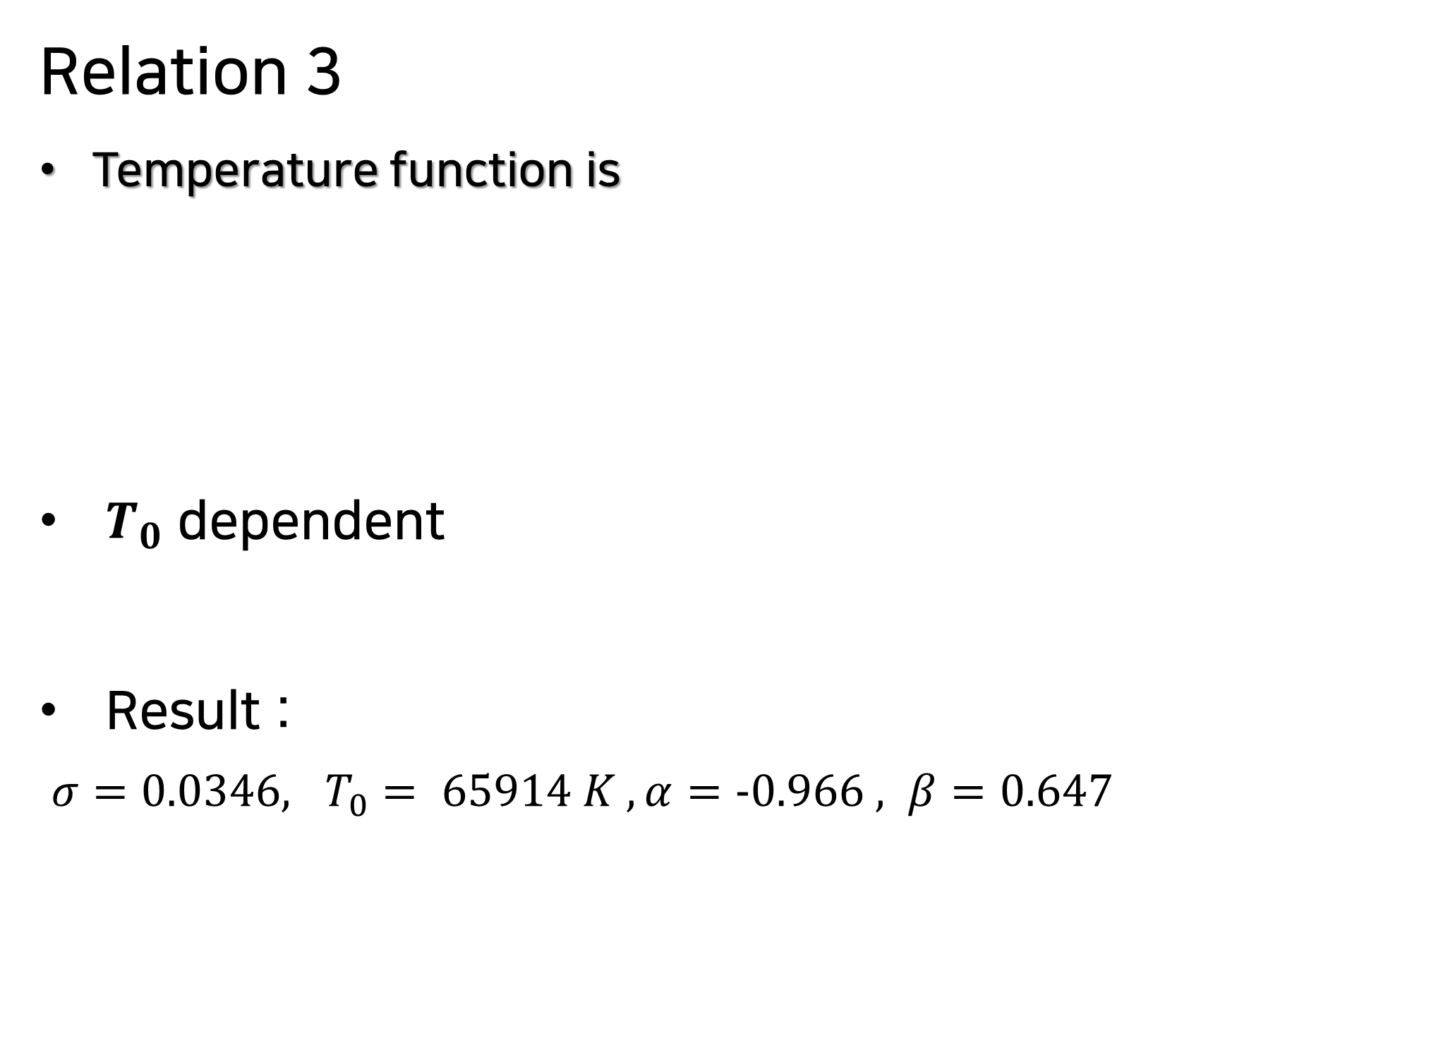

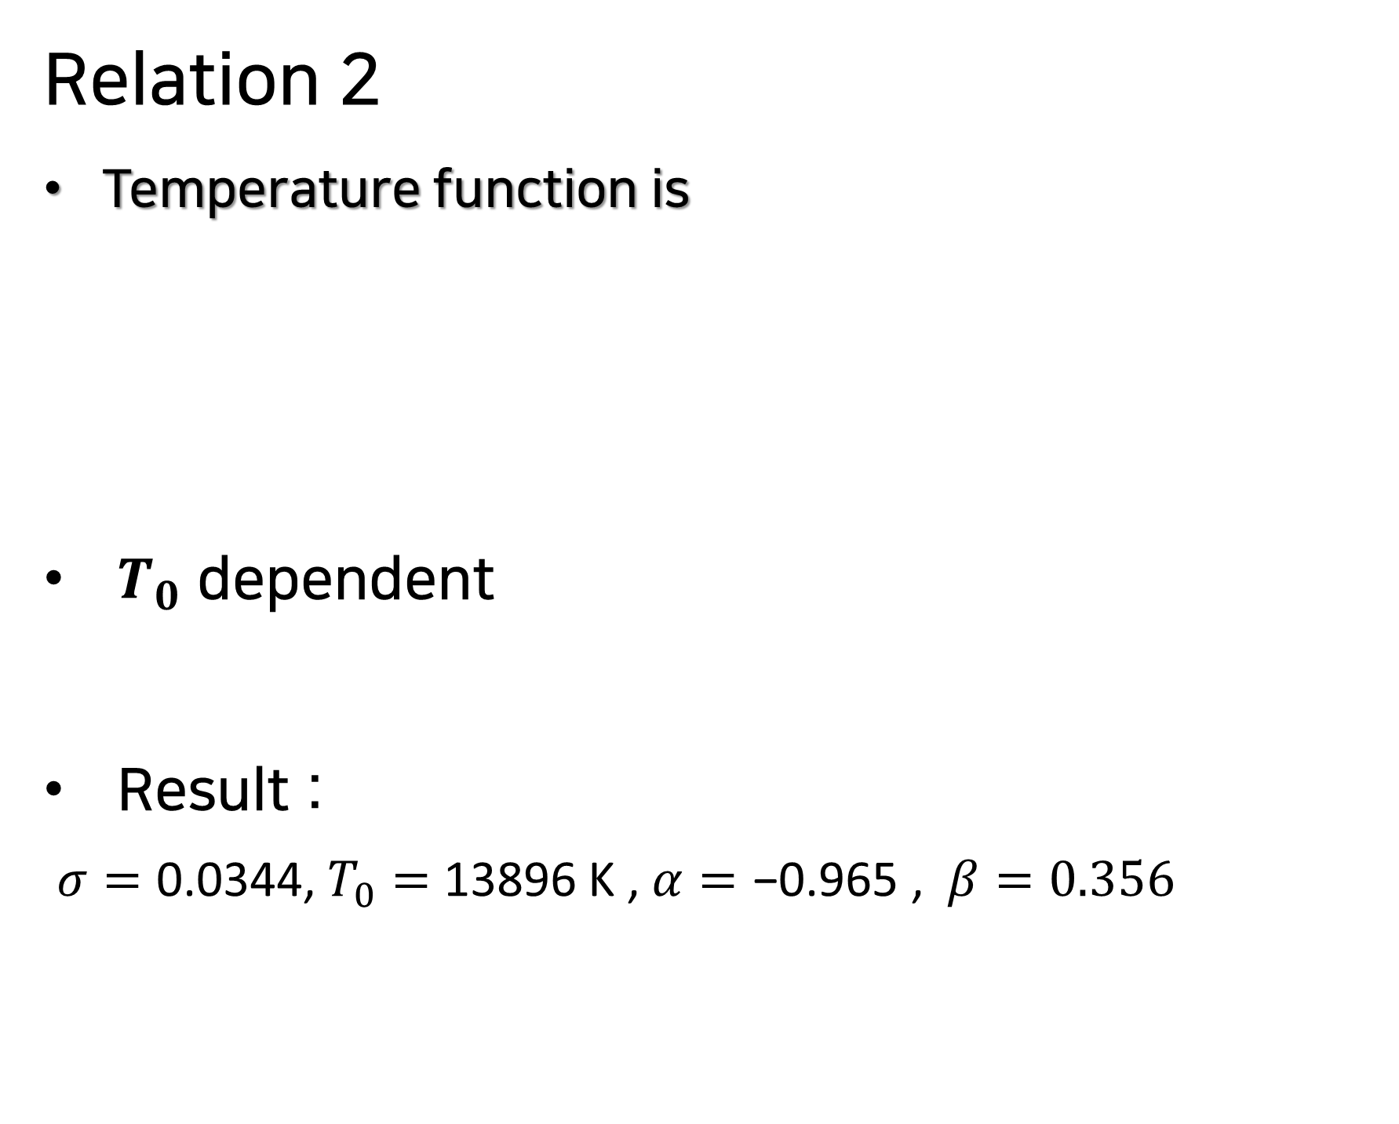
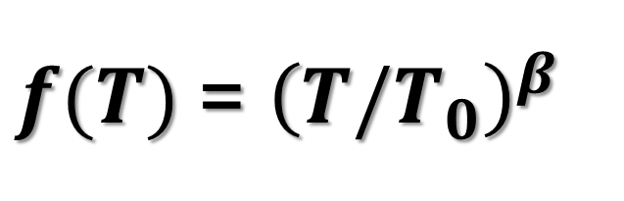

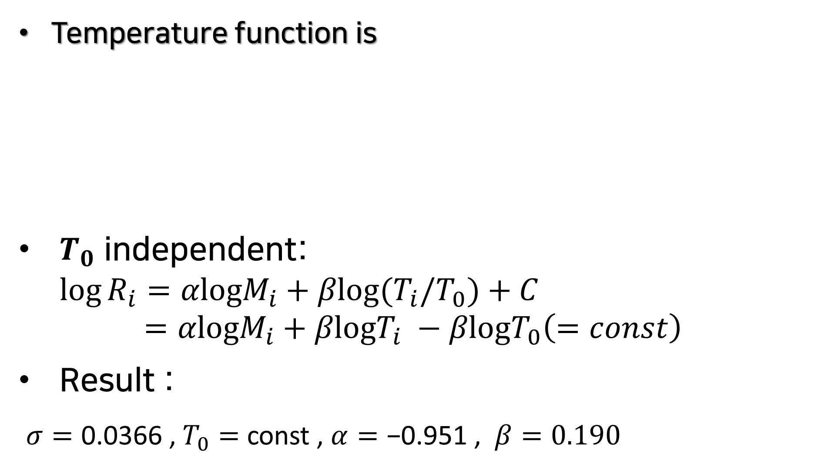

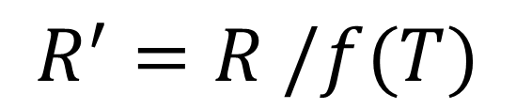
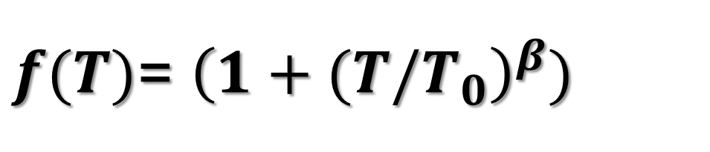
Temperature Normalized Relations with Model Agnostic
Relation 2
Temperature function is
$T_{0}$ dependent
Result :
$σ=\text{0.0344}$, $T_{0}=$ 13896 K , $α=\text{−0.965}$ , $β=\text{0.356}$
Relation 3
Temperature function is
$T_{0}$ dependent
Result :
$σ=0.0346, T_{0}= 65914 K , α=−0.966 , β=0.647$
$$R =R_{0}M^{α}f(T)$$
Temperature function is
$T_{0}$ independent: $\log{R_{i}}=αlogM_{i}+βlog{(T}_{i}/T_{0})+C$
$=αlogM_{i}+βlogT_{i} −βlogT_{0}\left(=const\right)$
Result :
$σ=\text{0.0366}$, $T_{0}=$ const , $α=\text{−0.951}$ , $β=\text{0.190}$
$$T/T_{0}$$
Relation -1
$f(T)$= ${\left(T/T_{0}\right)}^{β}$
$f(T)$= ${\left(1+(T/T_{0}\right)}^{β})$
$f(T)$= ${\left(1+T/T_{0}\right)}^{β}$
$$R^{′}=R /f(T)$$
$$f(T)$$
$${\left(1+T{/T}_{0}\right)}^{β}$$
Relation -2
$${\left(1+(T{/T}_{0}\right)}^{β})$$
Relation -3
Notes:
We used model agnostic method and made three temperature normalized relations for R-normalization,
Relation-1, Relation-2, Relation-3.
Let’s find out what changes by these three relations.
First, (enter) see Relation-1. When we see the Relation-1 , we can see the no variation for change T_0.
In this movie, T is T0. That means that Relation-1 has t0 independent. Because t0 term is going to constant in logarithm, so when t0 changed the optimal beta and minimum std not changed. And results show like this. (enter)
Second, Relation-2 . the relation-2 can see the lines in this movie. And T is also T0.
These lines change with T_0. And correspondingly, the optimal beta and minimum std also are changed.(enter) The right upper figure shows the trajectory of Relation-2. Blue dots are minimum std at each T0, and red dot is total minimum STD in range T0. From this result, (enter) Relation-2 has a T0 dependent (enter), and this result like this.
(enter)
Last is Relation-3.
The relation-3 also see similar trajectory with Relation-2. T is also T0 and blue dots are minimum std at each T0 and red dot is total minimum std in range t0. From this result, (enter) Relation-3 also has a T0 dependent (enter), and this result like this.
Now I’ll show the three relations results and summarize,

Slide 14
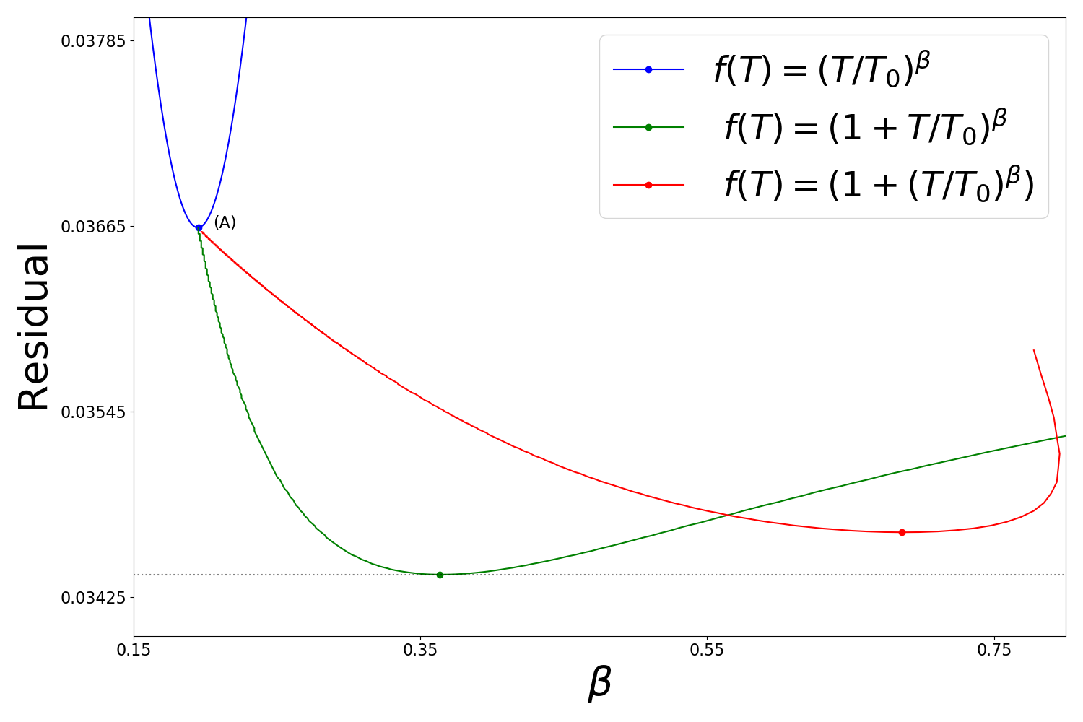
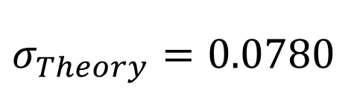
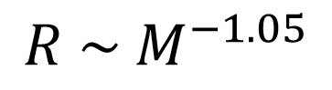
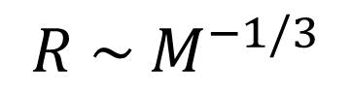
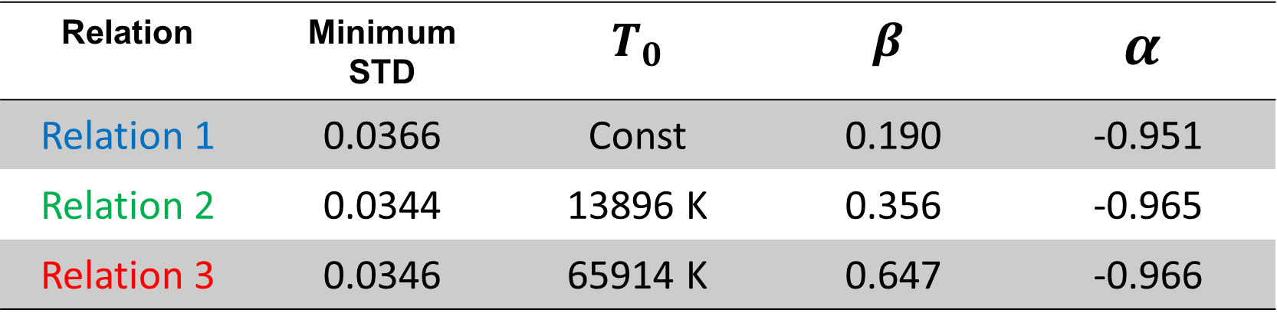
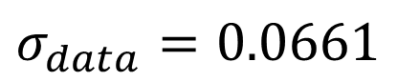
Result of three temperature normalized Relations
Relation 2 allows the lowest STD
Bifurcation point (A)
$$R \sim M^{−1/3}$$
$$R \sim M^{−1.05}$$
[unnormalized data]
$$σ_{Theory}=0.0780$$
$$σ_{data}=0.0661$$
Relation | Minimum STD | $T_{0}$ | $$β$$ | $$α$$
Relation 1 | 0.0366 | Const | 0.190 | -0.951
Relation 2 | 0.0344 | 13896 K | 0.356 | -0.965
Relation 3 | 0.0346 | 65914 K | 0.647 | -0.966
Notes:
Right figure shows the results of three temperature normalized relations.
Relation-1 case has constant t0, so we choose a certain t0 in this figure.
For this figure, we can see the (enter) Relation 2 is the lowest STD and (enter) bifurcation(버펄 케이션) point (A).
These results show that it is the mass primarily affect the radius and the temperature appears to be fin tuned.
And these three relations show that these results (enter) have lower STD than theoretical radius and mass relation and unnormalized data of radius and mass relation. (enter)
For this result, Relation 2 and Relation3 have similar minimum STD, so we use Monte Carlo method and ranked these two relations.

Slide 15
Ranking by Monte Carlo Simulations
Notes:
Now we using Monte Carlo simulation ranked the relations

Slide 16
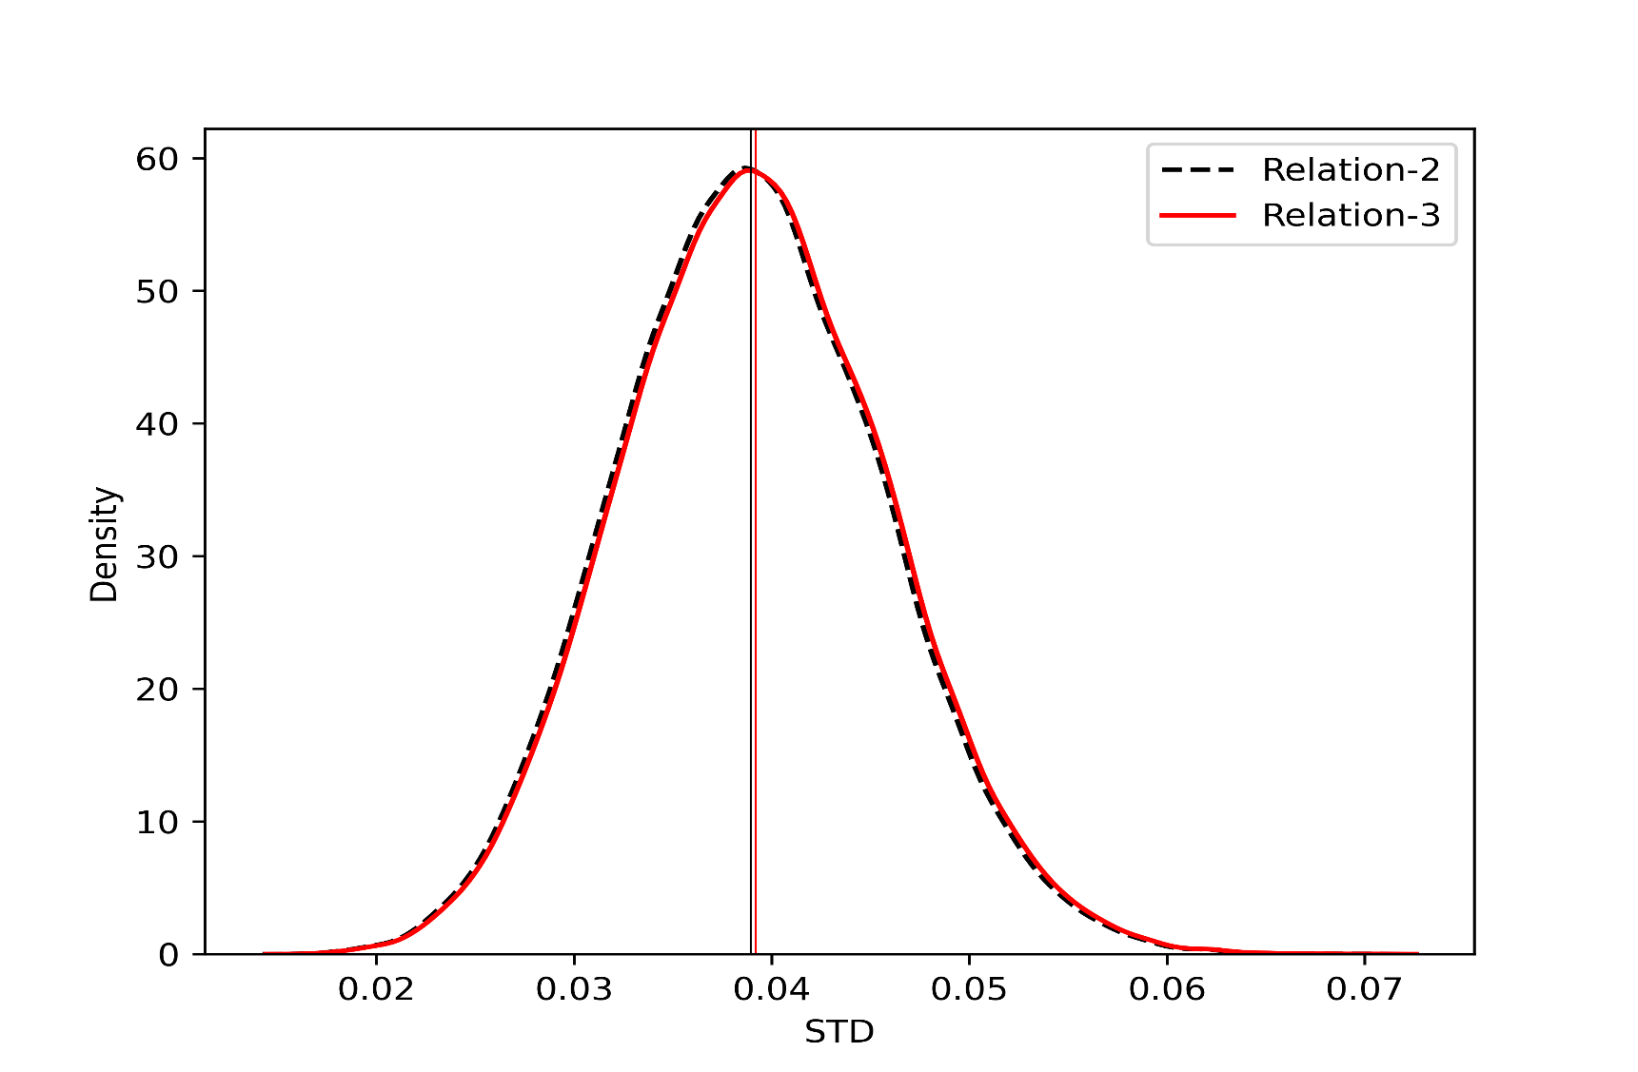
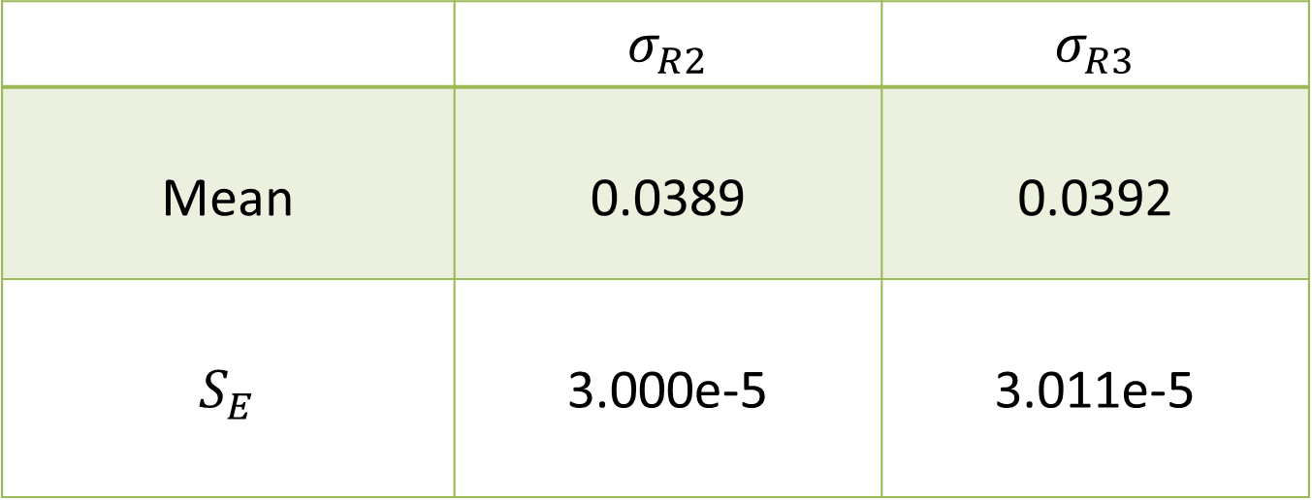
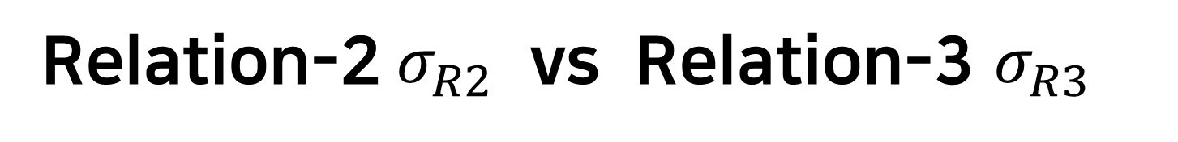
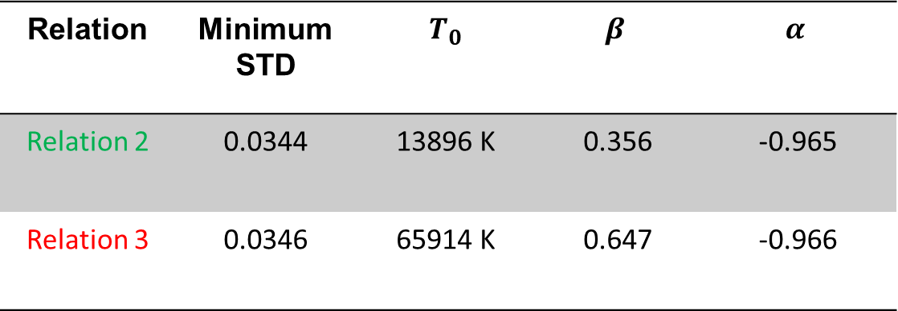

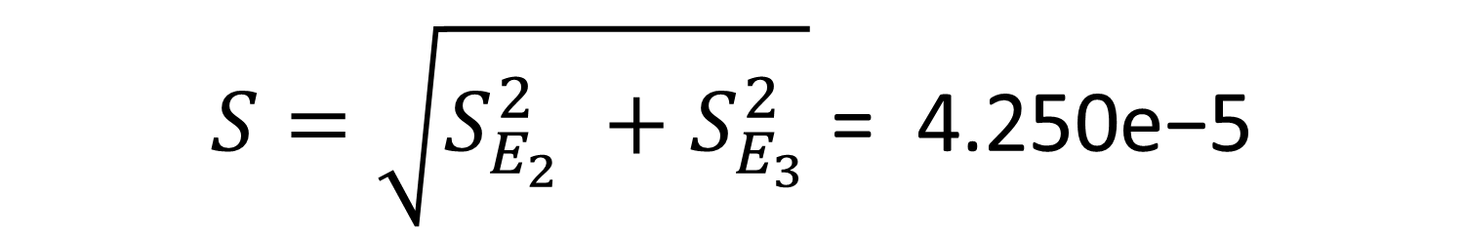
MC Results
Relation-2$σ_{R2}$ vs Relation-3 $σ_{R3}$
Relation | Minimum STD | $T_{0}$ | $$β$$ | $$α$$
Relation 2 | 0.0344 | 13896 K | 0.356 | -0.965
Relation 3 | 0.0346 | 65914 K | 0.647 | -0.966
 | $$σ_{R2}$$ | $$σ_{R3}$$
Mean | 0.0389 | 0.0392
$$S_{E}$$ | 3.000e-5 | 3.011e-5
$$D=\text{0.0389}\text{−0.0392 = −2.424}\text{e}\text{−4}$$
$$S=\sqrt{S_{E_{2}}^{2} +S_{E_{3}}^{2}} \text{= 4.250}\text{e}\text{−5}$$
$$d=D/S=6 σ$$
Notes:
For the result of Monte Carlo simulation, we get STD mean value of relation 2 and relation 3. See left bottom figure and right table, the std mean value looks like similar and trivial. However, standard error also has quite small value. Let’s see more detail, (enter) D is the difference of this two mean value like this, and (enter) S is Standard error like this, By dividing this two factor, we get 6 sigma confidence level about Relation 2. Now these diffecence is non trivial. It identifies Relation-2 to be preferred over Relation -3 at 6$σ$confidence level.
So, Relation -2 has lower mean STD than relation-3, we consider that Relation-2 is more precise relation.
(If chi square, we can’t get confidence level, chi square just give possibility.)

Slide 17
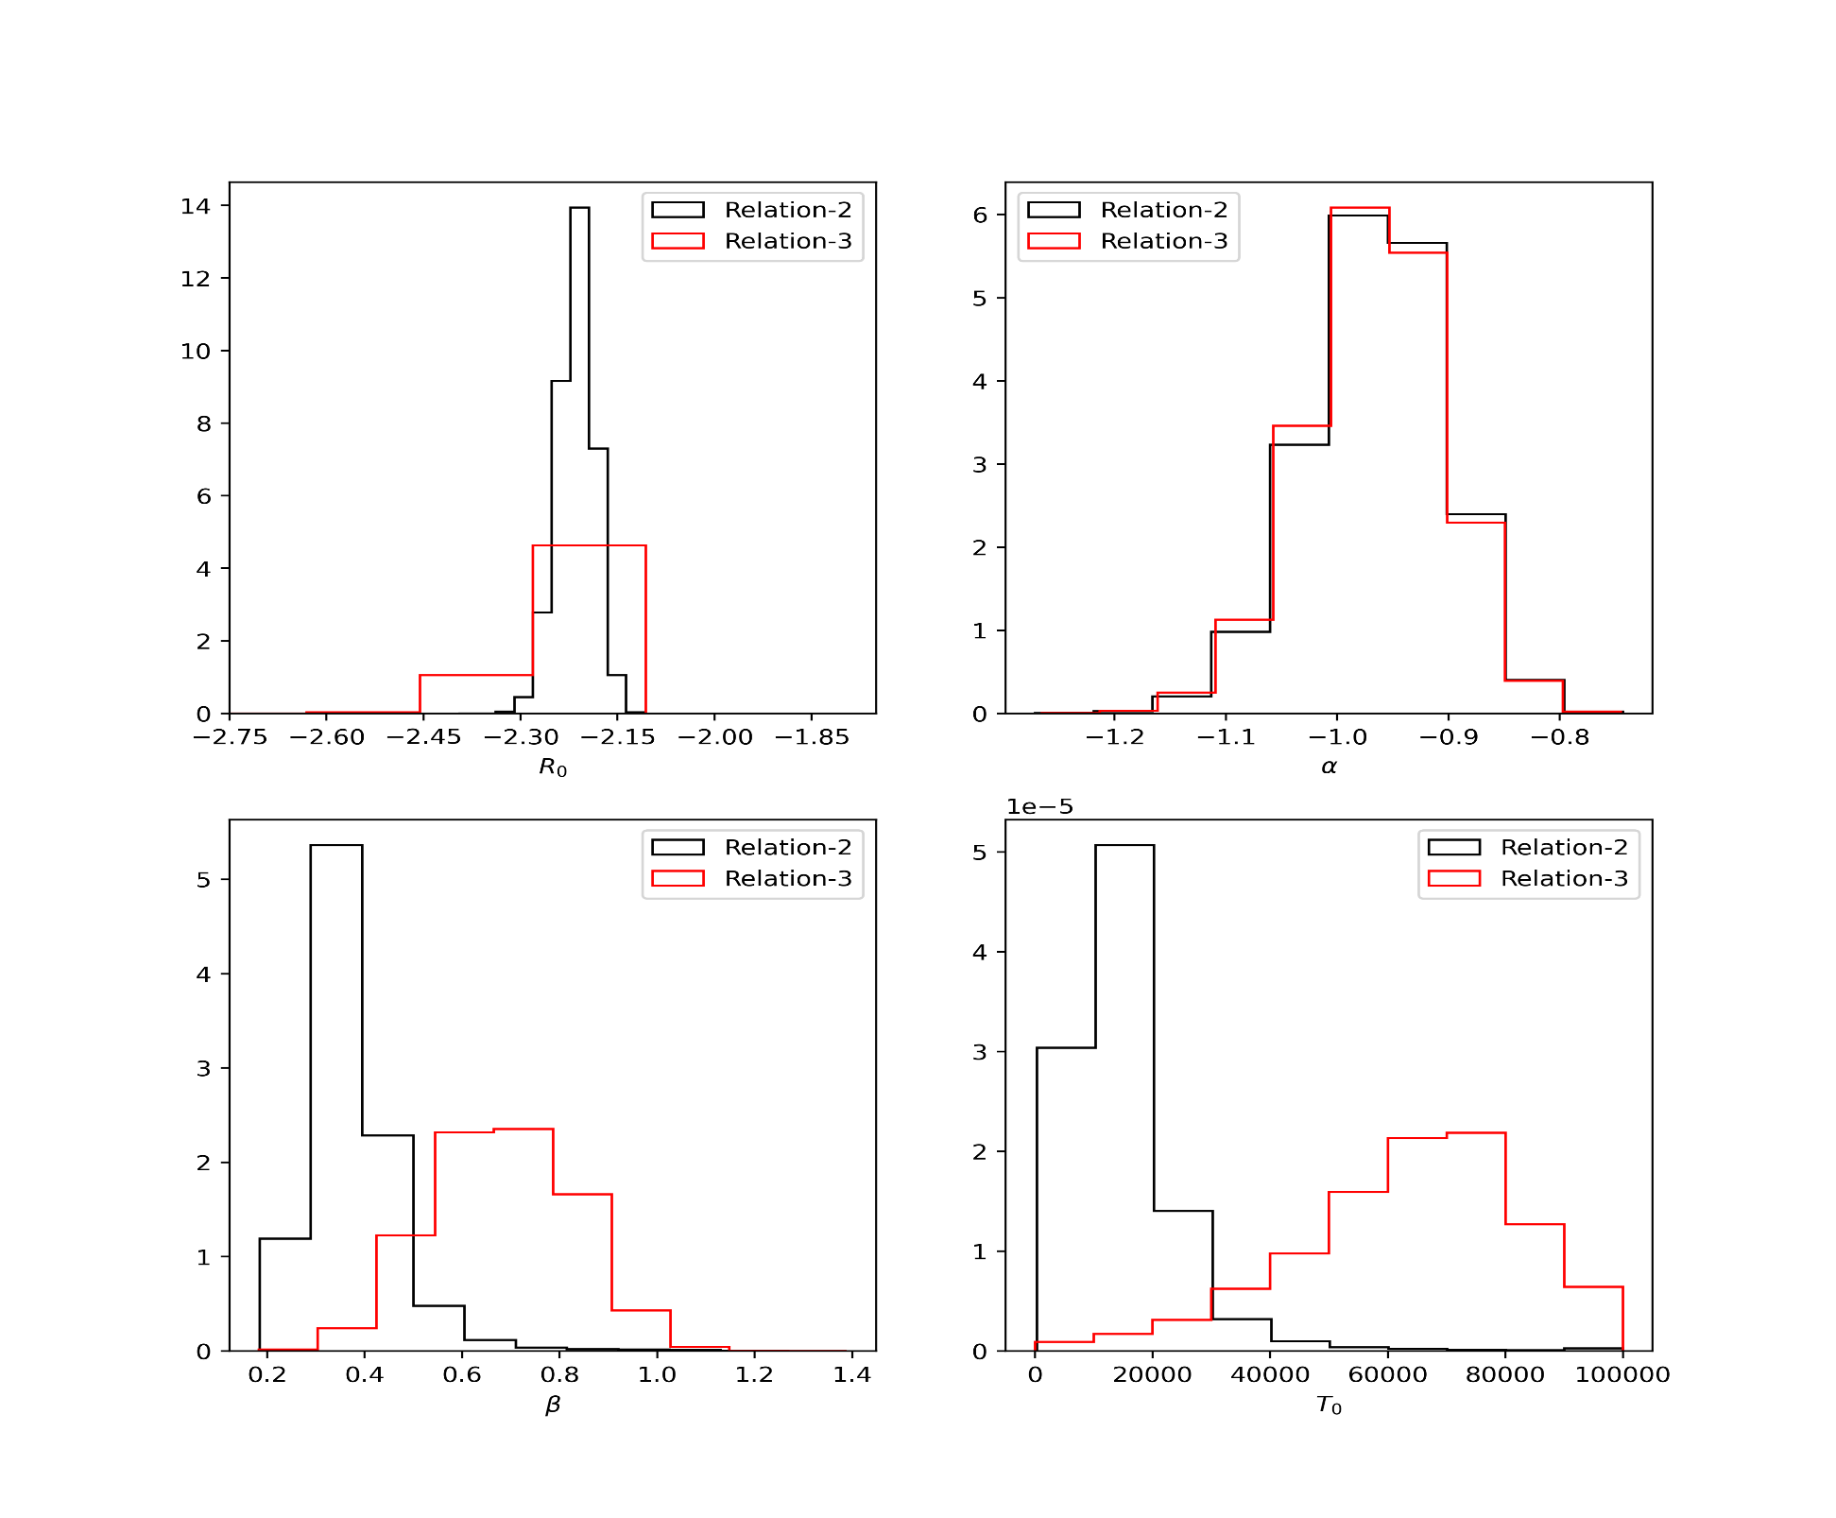
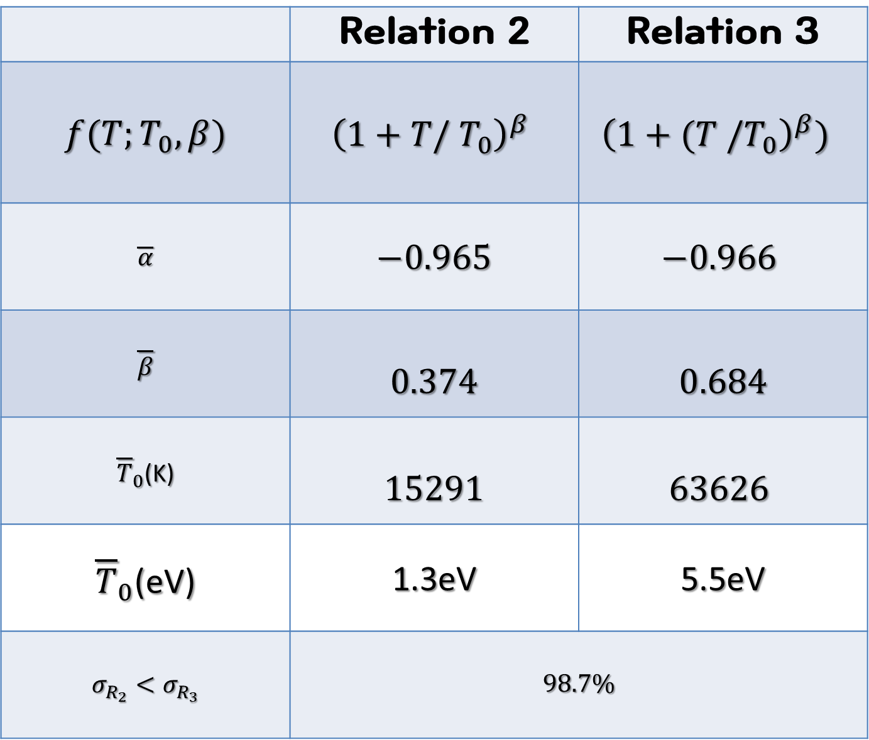
MC Results
Iteration : 50,000
 | Relation 2 | Relation 3
$$f(T;T_{0},β)$$ | $${\left(1+T/ T_{0}\right)}^{β}$$ | $${{\left(1+(T /T_{0}\right)}^{β})}^{ }$$
$$\overline{α}$$ | $$−0.965$$ | $$−0.966$$
$$\overline{β}$$ | $$0.374$$ | $$0.684$$
${\overline{T}}_{0}$(K) | $$15291$$ | $$63626$$
${\overline{T}}_{0}$(eV) | 1.3eV | 5.5eV
$$σ_{R_{2}}<σ_{R_{3}}$$ | $$98.7\%$$
Notes:
And During iteration, we also counted that which relation has larger STD. During 50,000 times, relation 3 account for 98.7 % higher STD.
For this reason, we choose relation-2 (enter), and we find (enter) a characteristic temperature 1.3eV in this result.

Slide 18
Interpretation of results
Notes:
Now I’ll interpret and analysis our results.

Slide 19
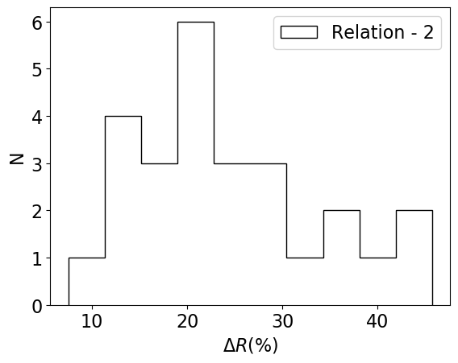
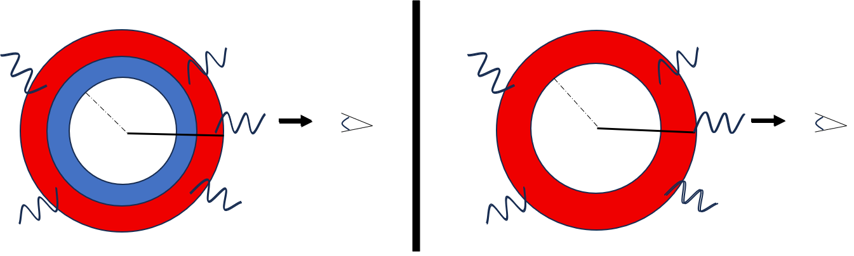
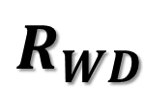


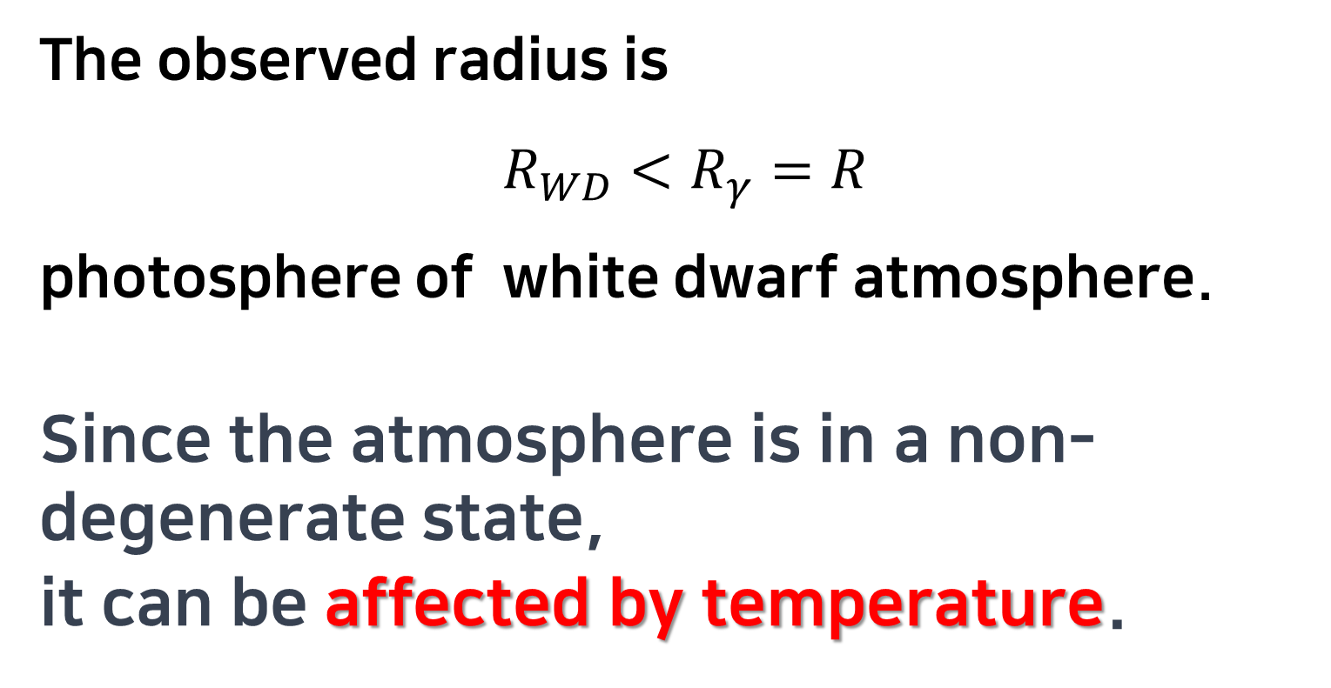
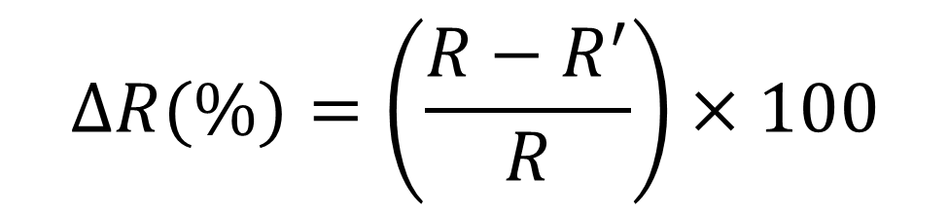
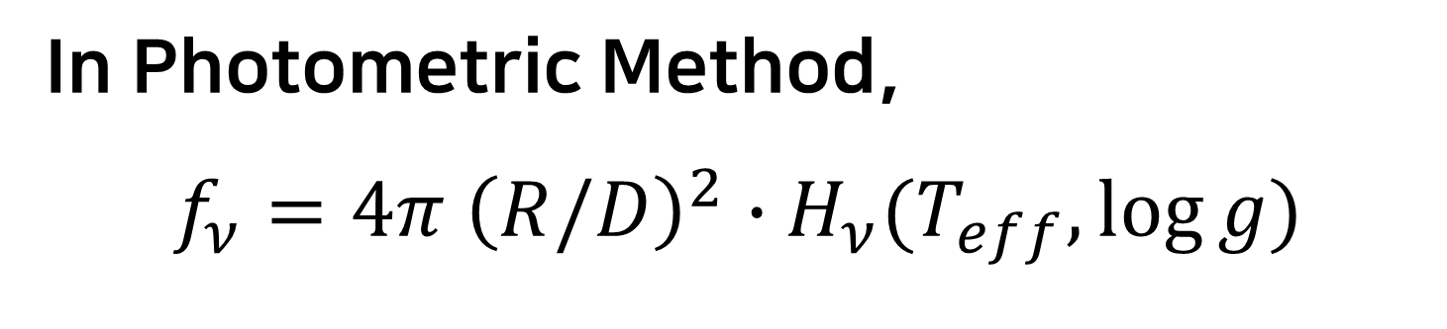
Radius Affected by Temperature
In Photometric Method,
$$f_{ν}=4π {\left(R/D\right)}^{2}∙H_{ν}(T_{eff},\log{g})$$
$$T_{0}=1.3 eV$$
$$R_{WD}$$
$$R_{γ}$$
The observed radius is
$$R_{WD}<R_{γ}=R$$
photosphere of white dwarf atmosphere.
Since the atmosphere is in a non-degenerate state,
it can be affected by temperature.
$$ΔR(\%)=\left(\frac{R−R^{′}}{R}\right)×100$$
Notes:
In Photometric method . Here h nu is surface flux called Eddington flux, and f nu is appearent flux and D is distance and R is radius. However, the observed radius is photosphere of white dwarf atmosphere.
(enter) Since the(디) atmosphere is in a non - degenerate state. (enter)
it can be affected by temperature.
This figure shows the (디) observed radius affected rate by temperature using Relation-2.
Now we compare the normalized radius results with theoretical radius and mass relation and unnormalized radius and mass relation.
(H nu = integral specific intensity 1 momentum .
specific intensity is the radiance of a surface per unit frequency or wavelength, depending on whether the spectrum is taken as a function of frequency or of wavelength. SI unit of spectral radiance in frequency is the watt per steradian per square metre per hertz (W·sr⁻¹·m⁻²·Hz⁻¹) )

Slide 20





Result of temperature normalized
(B)
Best fit for the observed radius and mass without temperature ($R\sim M^{−1.05}$) still have large scatter
Blue dot line is theoretical Radius.
(C)
Based on MC results,
Do R –normalization (R/f(T)) using Relation-2,
Now, we can see the tight and linear fit.
Blue dot line is theoretical Radius.
(A)
Theoretical radius ($R \sim M^{−1/3}$) and observed radius do not match.
$$f(T)={\left(1+\frac{k_{B}T}{1.3eV}\right)}^{0.374}$$
Notes:
Now, we can see the difference of relations results , (A) is theoretical relation, (B) is unnormalized relation and (c) is normalized relation.
First, (enter) Let’s see (A)
A is theoretical radius and observed radius figure.
Blue line is theoretical radius. And black dots are observed radius. It shows that theoretical radius and observed radius not match.
(enter)
Second, (B), Red line is best fit of the radius and mass without temperature. And blue dot line is theoretical radius.
However, It has still large scatter.
Lastly, (enter)Red line is the used temperature normalized relations. And blue line also theoretical radius.
Based on MC results, Do R-normalization using Relation-2
Now we can see the tight and linear fit.

Slide 21
Conclusions and Outlook
Notes:
Now I’ll show our conclusions and outlook.

Slide 22

White Dwarf (DA) Characteristic Temperature
Parsons et al. 2017 table shows a significant correlation
of radius with temperature.
A characteristic temperature
$T_{0}=1.3 eV$ in a model-agnostic analysis.
It is more likely a consequence of a hidden agent rather than the causal agent driving the observed correlation.
Notes:
Parsons (2017) table shows a significant correlation of radius with temperature.
We quantify a characteristic temperature $1.3 eV$ for this correlation in a model-agnostic analysis.
Since this temperature seems relatively modest.
It is more likely a consequence of a hidden agent rather than
The causal(코절) agent driving the observed correlation.

Slide 23
Corona ?
White dwarfs are known to have magnetic field.
However, it is inconceivable that 1.3 eV is relevant to temperature scale to a corona.
Notes:
So this temperature from Corona effect?
White dwarfs are known to have magnetic field. (enter)
However, it is inconceivable (컨씨버블) that 1.3 eV is relevant to temperature scale to a corona.
(Corona like sun, there is non-thermal state and extremely high temperature)

Slide 24






2. Ideal gas law at atmosphere ?
Photometric radius $,R_{γ}=R_{WD}+h$ ,defines $h$ is thickness.
Based on $k_{B}T=m_{i}gH$, $H$ is scale height.
$$H=H_{0} \left(\frac{m_{p}}{m_{i}}\right)\left(\frac{k_{B}T}{1eV}\right) \left(\frac{{10}^{6}m/s^{2}}{g}\right)$$
$H_{0}≃1\%H_{⊕}$ , $H_{⊕}$ = 9 km
The mass of the atmosphere is expected to be no more than ${10}^{−4}M_{⊙ }$.
Using outer opacity condition of the atmosphere :
$$h=H\log{{(σ}_{T}n_{0}H)}$$
$$h=0.1\%R_{WD}$$
This means $R_{γ }≈R_{WD}$ .
Notes:
The other is Ideal gas law at atmosphere?
Based on ideal gas law (enter), we can get scale height. (enter) And using Opacity condition of the atmosphere, (enter) We get the this equation. For this equation, we induce this one.
(enter)
This means that it is sill remarkably thin.
높이 척도, 자연상수에 대해 지수적으로 감소하는 거리.
(scale height is a distance over which a physical quantity decreased by a factor of e ) (Euler constant)
R = R0 e^(-z/H) e is expotential
N0 particle number density ,
Gt is Tomson scatter area,
Outer envelope opacity is 1 -> Gt * n0 * e (-h/H) = 1

Slide 25

Our model-agnostic approach identifies Relation-2 to be preferred over
Relation -3 at 6$σ$confidence level.
Relation-2 identifies a characteristic temperature of 1.3 eV = 15291 K.
Conventional atmosphere can not explain the observed expansion of the photosphere.
Accretion process and tidal interaction in these binary systems ?
What would be the results for the other white dwarf classes ?
Notes:
Our model-agnostic approach derived Relation-2 and Relation-3 STD have 7 sigma and characteristic temperature 1.3 eV.
Conventional atmosphere can not explain the observed expansion of the photosphere.
To consider more advanced atmospheric (엣모스피어릭) model, perhaps accounting for deviations of spherical symmetry due to accretion process and tidal interaction in these binary systems.
Further more, we have to check that the other types of white dwarfs.
Chi2 안 쓴 이유, 우선 log log plan에서 보고 constant 항을 무시하기 위해서이며, 우리는 error를 고려하지 않았기 때문이다.

Slide 26






감사합니다
Dank u
Merci
Thank you
Gracias
Cảm ơn
Vielen Dank

Slide 27
Q & A

Slide 28













04. Ranking by Monte Carlo Simulation
*Monte Carlo
$$[α_{1} , β_{1}]$$
$$[α_{50,000} , β_{50,000}]$$
$$[α_{0} , β_{0}]$$
$$[α_{2} , β_{2}]$$
Original
Set 1
Set 2
Original
Set 2
Set 3
Set 1
Set 50,000
$$[α_{1} , β_{1}]$$
$$[α_{3} , β_{3}]$$
$$[α_{0} , β_{0}]$$
$$[α_{2} , β_{2}]$$
Notes:
First, we calculated with original data, and using this data we can get the optimal alpha and beta.
And then we make random noise and test changed data. (enter)
We can get new optimal alpha and beta for set 1. (enter,)
Once again, we make other random noise and test changed data. (enter, enter)
Repeat until 50,000 times, we can get 50,000 number of alpha and beta.
Based on these parameters, according to Center limit theory, we can get mean and standard deviation of parameter.

Slide 29





03. Temperature Normalized Relations
* Parameter Estimation Method
But,
LS uses Singular Value Decomposition (SVD),
ODR is repeatedly update parameter
to minimize $χ^{2}$
$$f\left(x_{i}\right) ≠g(x_{i})$$
ODR method vs LS method
Least Square
$$χ_{LS}^{2}=\sum{{\left(y_{i} −f\left(x_{i}\right)\right)}^{2}}$$
ODR (Orthogonal Distance Regression)
$$χ_{ODR}^{2}=\sum{\frac{{\left(y_{i} −g\left(x_{i}\right)\right)}^{2}}{σ_{y_{i}}^{2}+σ_{x_{i}}^{2}[g′(x_{i})] }}$$
ODR method is useful if two variables have errors
$$χ_{ODR}^{2}≃\sum{{\left(y_{i} −g\left(x_{i}\right)\right)}^{2}} (σ_{i}≪1)$$
If these errors too small,
considering errors might not be useful.
In this case, ODR doesn’t use errors,
similar to utilizing LS.
Notes:
Before the test, we also consider the parameter estimation method.
We test two method that Least square and ODR method. (enter) Least square method is usually used to estimate parameter. It is minimize to chi square. (enter) Orthogonal distance regression is useful if two variable have errors, (enter)
however, If these errors too small, considering errors might not be useful. In this case, ODR doesn’t use errors, and just used similar to LS.
(enter) But, Least Square uses SVD method and ODR is repeatedly update parameter to minimize $χ^{2}.$ So they can have different result. (enter) This figure show that ODR and LS result. In this case, since ODR method gives lower chi square (enter), we chose ODR method.
Now, we test three temperature normalized relations, each relation has different temperature function.

Slide 30



$$ε_{i}=\left(logR_{i}−{logR}_{est}\right)$$
$=\left(logR_{i} −αlogM_{i} −β\log{f\left(T\right)}−b\right)$
$=logR_{i}^{′}−αlogM_{i} −b$
$$\overline{ε}=\overline{A} −b$$
$$A_{i}=logR_{i}^{′}−αlogM$$
$$σ^{2}={\left(ε_{i}−\overline{ε}\right)}^{2} ={\left(A_{i} −\overline{A}\right)}^{2}$$
Notes:
(STD를 사용해서 Constant term 사라지게 만들기.)
우선

Slide 31
A catalogue of white dwarfs in Gaia EDR3 N. P. Gentile Fusillo

Slide 32


01. Introduction
*Spectroscopy
1. Spectroscopic method (X-shooter)
: To calculate $\log{T_{eff}}$and $\log{g}$
Temperature and surface gravity affect to spectra shape
Using atmosphere model, find the lowest $χ^{2}$ to Balmer lines data (Red lines)
Credit: Chandra et al.(2020) in Fig 4
Notes:
First, Parsons used X- shooter technique which spectroscopic method because it is useful to calculate effective temperature and surface gravity. Spectra shape are affected to surface gravity and effective temperature.
Use atmosphere model and find the best fit.
Red line is the lowest chi square fitting to observed Balmer lines.
From this, spectroscopic method can get surface gravity and effective temperature.

Slide 33



01. Introduction
*Photometry
Credit: Chandra et al.(2020) in Fig 3
2. Photometric method (ULTRACAM , ULTRASPEC )
: To calculate Radius
Stefan-Boltzmann Law
$$L=A σ T_{eff}^{4} , A=4πR^{2}$$
Challenging to get Bolometric Luminosity
Spectral Energy Distribution (SED) and Distance
$$f_{ν}=4π {\left(R/D\right)}^{2}∙H_{ν}(T_{eff},\log{g})$$
Instead
$H_{ν}$: Eddington flux (Surface flux) of white dwarf
$f_{ν}$: apparent flux
R : radius of white dwarf , D : distance
Notes:
And Parsons also use Photometric method, such as ULTRACAM and ULTRASPEC(스펙), it is useful to calculate radius.
Theoretically, we can get radius using Stefan –Boltzmann law. However it is challenging to get bolometric luminosity.
So, recently (enter) photometric method use (enter) Spectral energy distribution method with distance.
From this , photometric method can get white dwarf radius. (# Surface flux also can get atmosphere model.)
So, Parsons used these two method, spectroscopic and photometric method, Parsons can get precise white dwarf information.
Then, why we don’t use other study like using thousands samples?

Slide 34


End of the stars
Main Sequence Star
White Dwarf
Credit: NASA/SDO
Credit: R. Hollow, CSIRO.
Credit : Youtube-Kurzgesagt: White Dwarfs & Blackhole
Notes:
White dwarf is known for the end of the middle mass star. These stars follow H-R diagram evolved to white dwarfs. There is a typical white dwarf. That is Sirius B

Slide 35




01. Introduction
Finally, finished nuclear synthesis, outer envelope spread to Universe (PNe)
* End of the stars
Center of PNe has a compact star
A single- star Evolution
MS evolution
to RGB, AGB
$0.4<M/M_{⊙}<8$, Main Sequence star bunning H
Sun
Arcturus
M 57
Credit: NASA/SDO
Credit: NASA’s Goddard Space Flight Center/Chris Smith (KBRwyle)
credit: NASA and ESA
Credit : Youtube-Kurzgesagt: White Dwarfs & Blackhole
Notes:
First, a single star evolution. Light and middle mass Main sequence stars are burning Hydrogen in their core. (enter)
When they finished burning hydrogen, MS are evolved to Red Giant Branch and Asymptotic giant branch. (enter)
Finally, when they ceased nuclear synthesis, outer envelope spread to Universe like Planetary Nebula, and center of Planetary Nebula has a compact star, called White Dwarf.

Slide 36




01. Introduction
Finally, this system form White Dwarf and MS (or RGB).
* End of the stars
Binary-star Evolution
RGB
3 $M_{⊙}$ MS
WD
MS
or
RGB
1 $M_{⊙}$ MS
MS
In two MS binary system, the more massive star evolves to RGB phase first
RGB fills the Roche Lobe, and then residual matters are crossed the Roche Lobe and swallowed to MS.
Notes:
The other scenario, binary star evolution.
In two Main Sequence binary system, the more massive star evolves to RGB phase. Like this case, 3 solar mass is going to RGB phase first. (enter) And then RGB fills the Roche Lobe and the residual matters are crossed the Roche lobe and swallowed to MS. (enter)
Finally, this system form white dwarf. Next, I will present the(디) observed and theoretical properties of white dwarfs

Slide 37



01. Introduction
*One example of study – Candra et al. 2020
Comparing other study (Chandra)
Many studies used a photometric (spectroscopic)
method get radius ($\log{g},T_{eff}$), and then using model
or other methods, estimate other value.
However, during this process, it brings uncertainties.
Ex) Gravitational Redshift
$$V_{z}=\frac{λ_{obs} −λ_{rest}}{λ_{rest}}×c =\frac{R_{g}}{R}c$$
Using Gravitational redshift method can bring
quite large errors.
Comparing other study (Chandra)
Using noiseless radius samples,
redshift errors purely go to Mass error.
In photometric method ,
$$f_{ν}=4π {\left(R/D\right)}^{2}∙H_{ν}(T_{eff},\log{g})$$
T_{eff} and $\log{g}$ set free parameter.
In spectroscopic method,
They get radius and mass used model.
However,
Parsons use two method and get data based on the observable data.
Credit: Chandra et al.(2020) in Fig 5
Notes:
Because other samples have quite uncertainties. (enter) One example is 2020 Chandra study. Many studies used one method, like use a photometric method and get white dwarf radius. And then using models or other methods, estimate other value. However, during this process, it brings uncertainties. One example is using gravitational redshift. Using the observed gravitational redshift method can bring quite large errors. (enter)
And there are some constrains in Chandra study, (enter)
One is using noiseless radius samples, so redshift errors purely go to mass errors. And In photometric method, they set effective temperature and surface gravity as free parameter . And in spectroscopic method, they get radius and mass used model.
However, Parsons use both two method and get white dwarf properties based on the observed data.
So, we choose Parson data.

